Slide 1

Proposed 2023-2027 Capital Improvement Program (CIP)
August 30, 2022

Slide 2
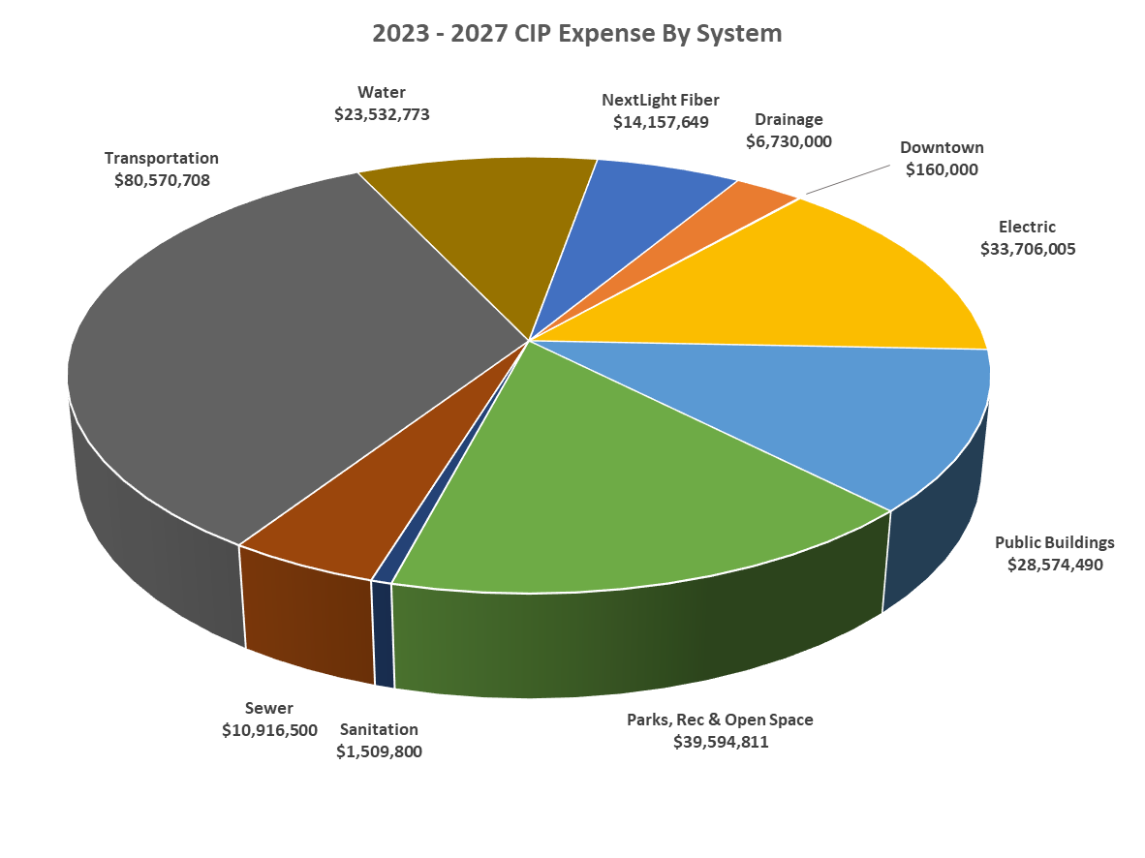
2023-2027 Proposed CIP Expense
5-YR CIP - $239.45 M
Key Investment Areas 2023 - 2027
Transportation – 33.6%
Parks, Rec and Open Space – 16.5%
Electric – 14.1%
Public Buildings – 11.9%

Slide 3
2019-2027 CIP Trends
CIP Overview
CIP expense is variable year-to-year depending on investment projects
CIP spending trended up in 2022 due to one-time Transportation and Water expenses
2023 CIP is $175M, 75%, below 2022 Revised Budget
$239M

Slide 4
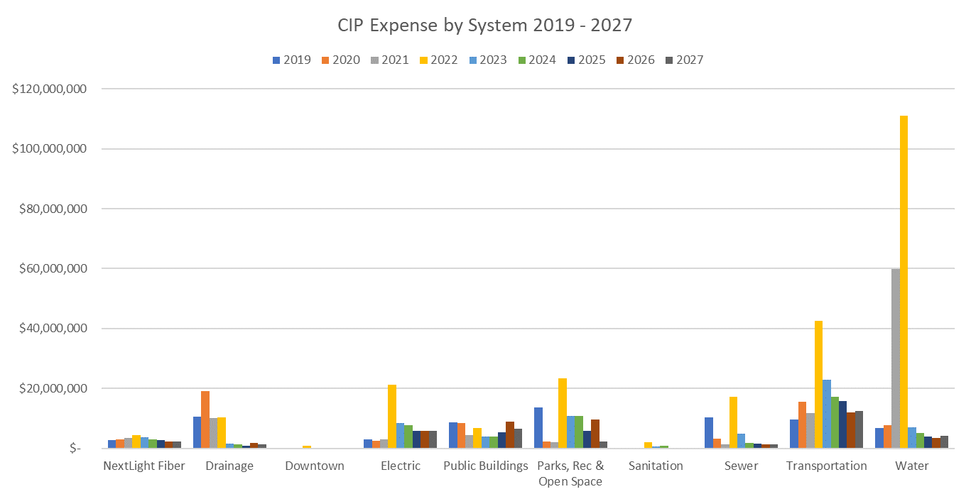


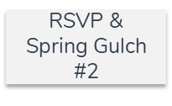
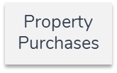


2019-2027 CIP Trend Detail
Notable 2019-2022 investments in Drainage, Electric, Parks, Sewer, Transportation, Water

Slide 5
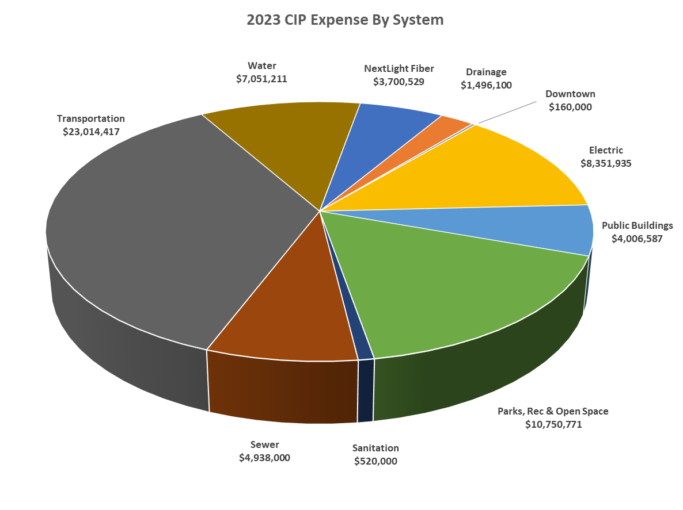
2023-2027 Proposed CIP Expense
2023 CIP - $63.99 M
Key Investment Areas 2023 - 2027
Transportation – 36.0%
Parks, Rec and Open Space – 16.8%
Electric – 13.1%
Public Buildings – 11.0%

Slide 6
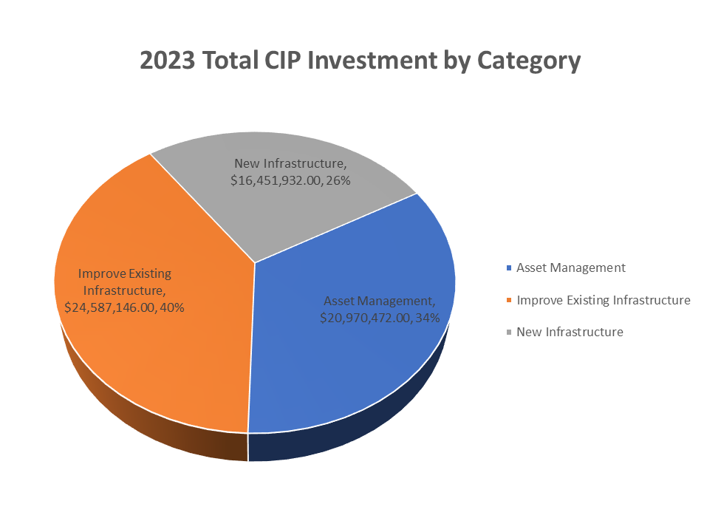
CIP by Investment Category
Highest level of investment in improving existing infrastructure (39.6%)
Categories vary by infrastructure category as demonstrated in the following slides
Category Definitions
Asset Management – renewal of infrastructure to maintain intended function
Improve Existing Infrastructure – enhancement, upgrade, or added functionality
New Infrastructure – Newly constructed infrastructure

Slide 7

2023 Capital Improvement Program Details

Slide 8
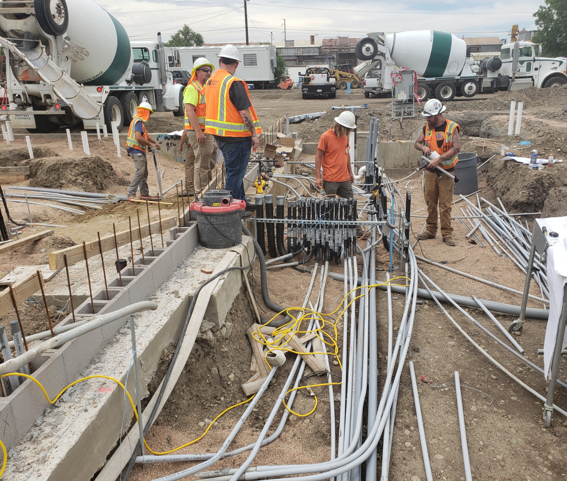
Project Delivery Challenges
Higher Inflation
Product Availability/Timelines
Staffing
Regulatory Environment

Slide 9
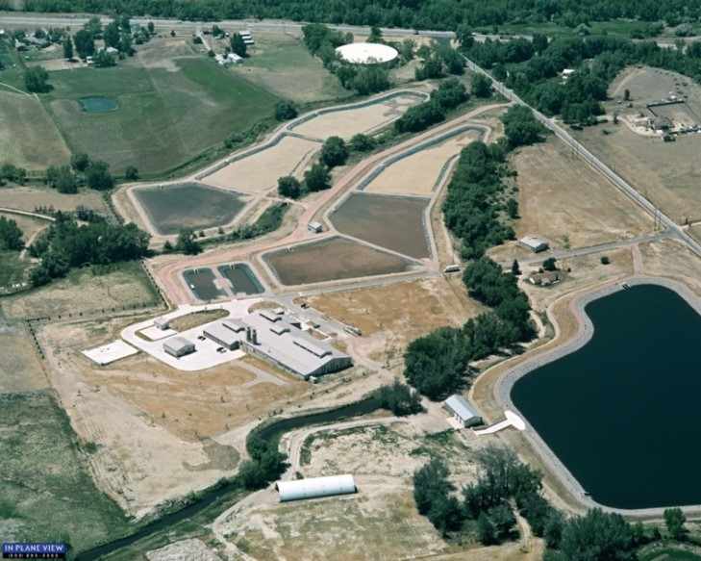
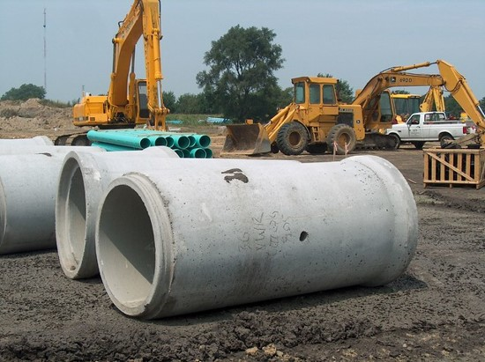
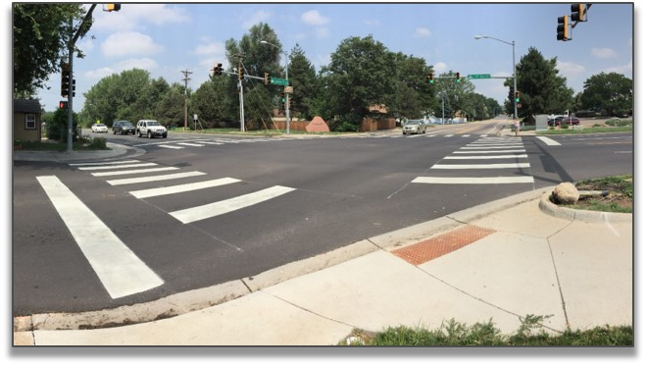
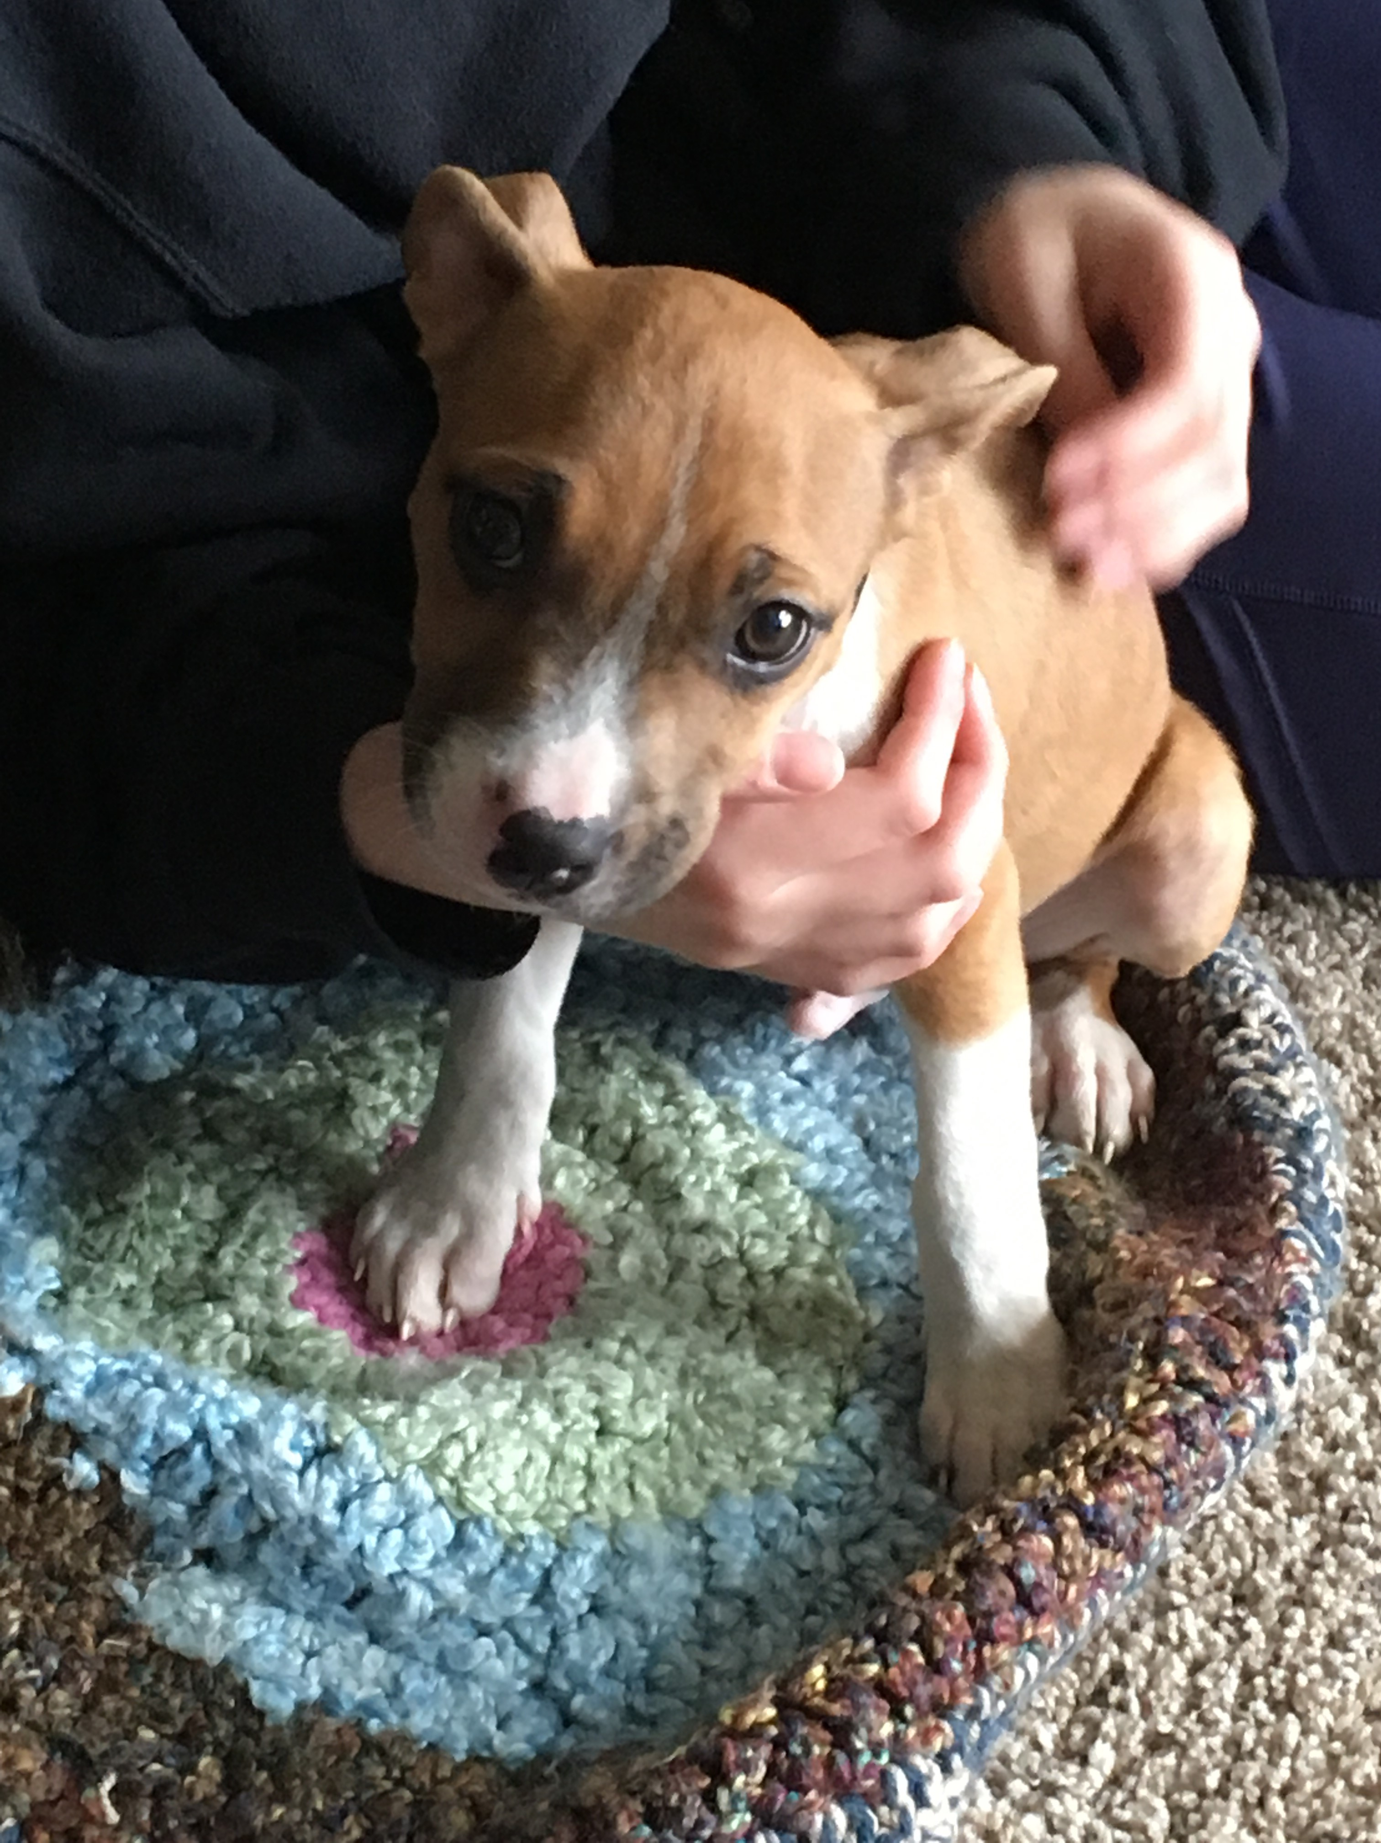
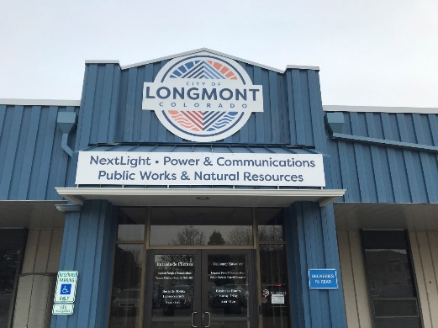
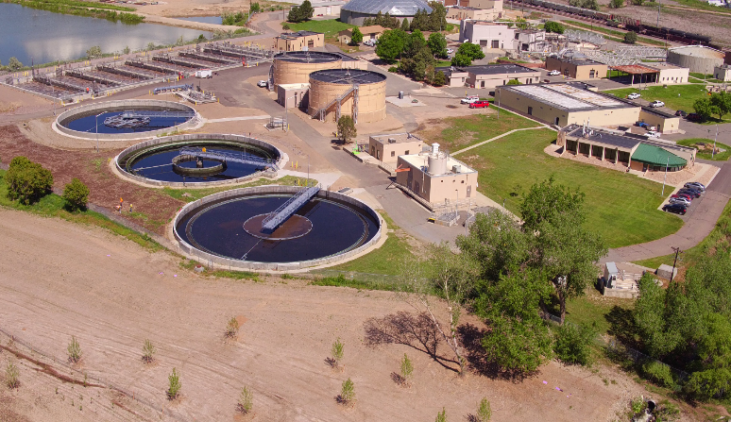
2023 CIP
Transportation
Water
Sewer/Wastewater
Drainage
Public Buildings
Jim Angstadt

Slide 10
2023 CIP – Transportation $23M, 36% of total 2023 CIP
Notable Projects
Coffman St. Busway Improvements - $8,232,000
1st and Main Transit Station Area Improvements - $505,000
Boston Ave Connection – Price to Martin - $370,000
Transportation of the Future* - $150,000
*not a capital expenditure

Slide 11
2023 CIP – Water $7.1M, 11% of total CIP
Notable Projects
North St Vrain Pipeline Replacement - $600,000
Raw Water Irrigation & Park Pond Improvements - $148,488
Ralph Price Reservoir Improvements - $999,000
WGFP
Bond Projects

Slide 12
2023 CIP – Sewer $4.9M, 7.7% of total CIP
Notable Projects
WWTP Regulation 85 Improvements - $2,828,000
Digester No. 4 - $800,000

Slide 13
2023 CIP – Drainage $1.5M, 2.3% of total CIP
Notable Projects
Storm Drainage Rehabilitation & Improvements - $992,850

Slide 14
2023 Public Buildings CIP – $4M, 6.3% of Total CIP
Notable Efforts
Ongoing Maintenance of Facilities
Notes:
- Includes approximately 34 municipal facilities. (These are not bond related projects).
- Covers on-going repairs and life cycle replacements of multiple core building systems. (Examples: roofing, HVAC, Boilers, and flooring).
- These funds support keeping the infrastructure and systems working properly.
- Repairs increase 5-7% per year as the building systems age until expected life cycle is met and replacements are planned.
- Funds also cover emergency failures of systems when failure is outside the life expectancy.

Slide 15
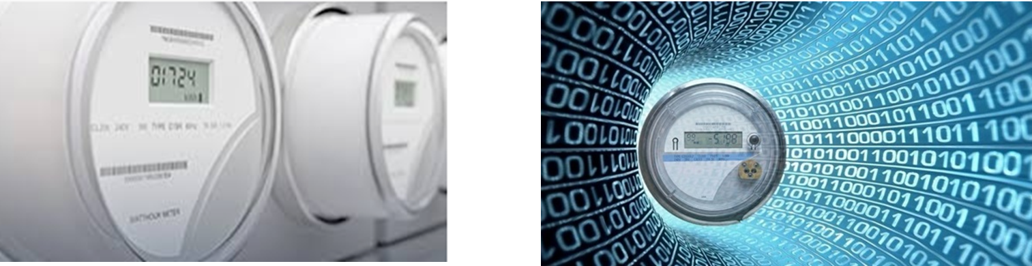
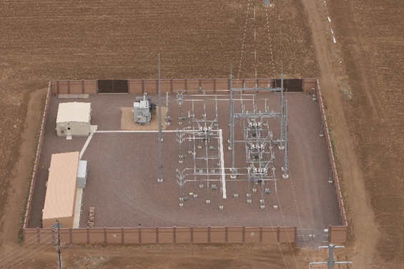
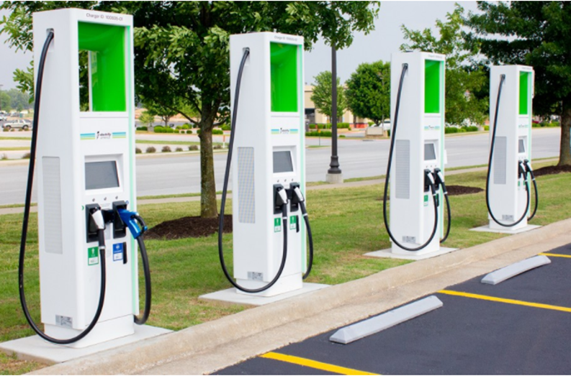
2023 CIP – PBF-225 Electric Vehicle Charging Stations
Cash Johns, Fleet Manager
Considered the next five years of potential EV vehicle purchases (177 vehicles) based on current market and planned charging stations accordingly with assistance from LPC and Facilities. Re-evaluation of market and additional charging stations annually.
2023 – 9 Level II stations (dual plug)
3 Level III stations (quick charge)
$362,845 total
2024 – 14 Level II stations (dual plug)
$319,870 total
2025 – 2 Level II stations (dual plug)
$41,410 total

Slide 16
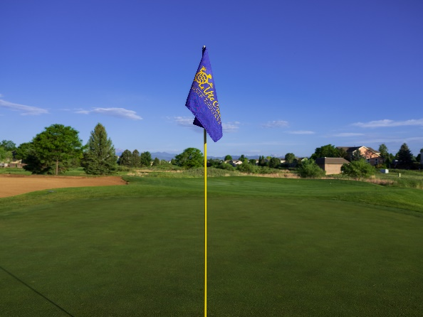
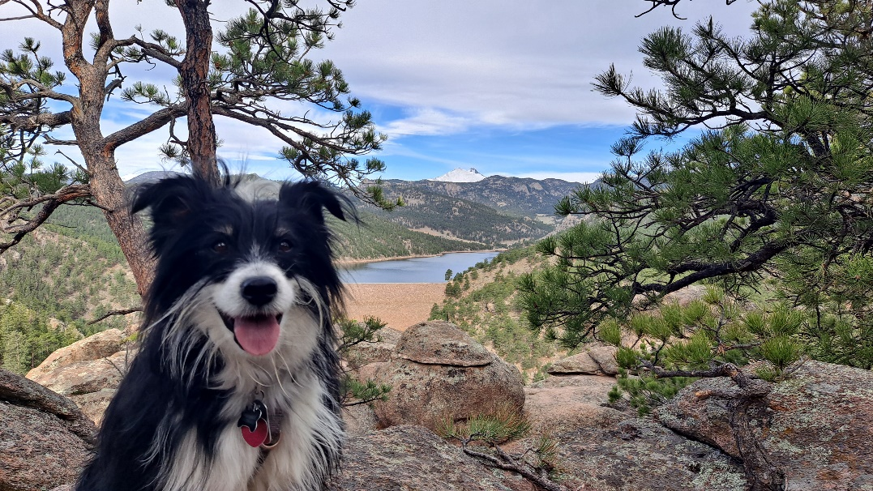
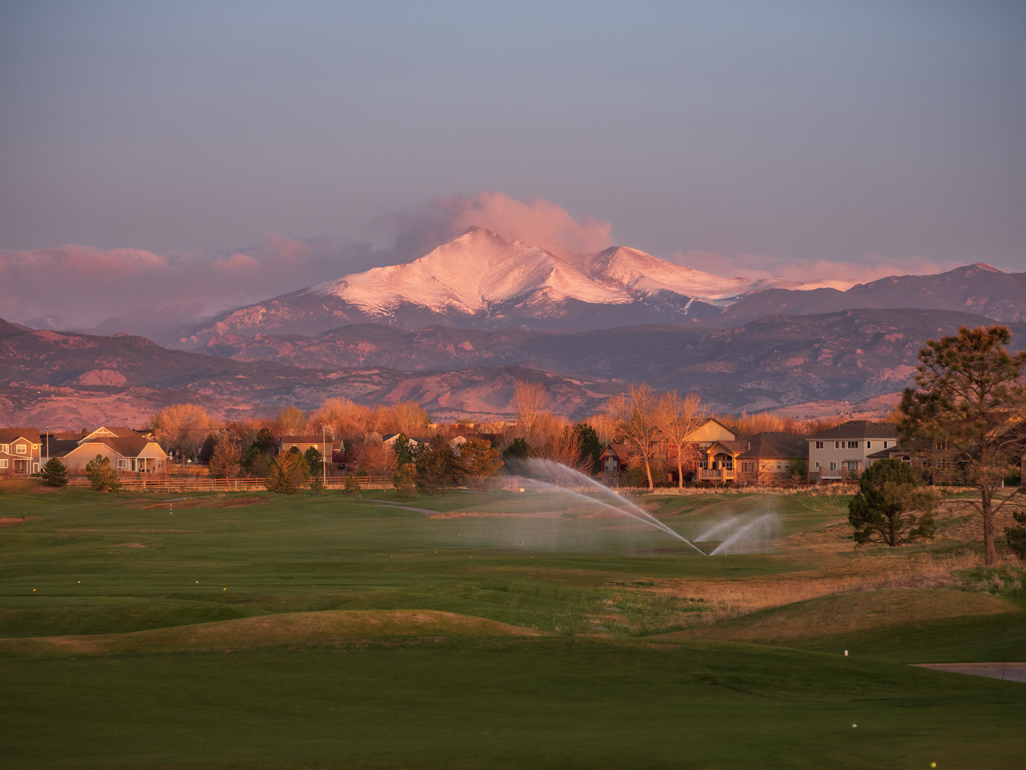
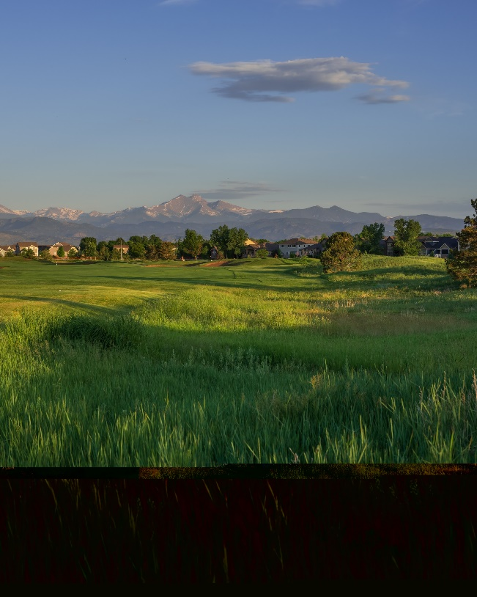
2023 CIP – Parks, Rec & Open Space
David Bell & Jeff Friesner

Slide 17
2023 CIP – Parks, Rec, Open Space, $10.7M, 16.8% of Total CIP
Notable Projects
St. Vrain Greenway - $750,000
Fox Meadows Neighborhood Park - $2,307,800
Dry Creek Community Park - $454,000
Primary & Secondary Greenway Connections - $940,000
Park Infrastructure Rehab & Replacement - $1,068,000
Ute Creek Maintenance Facility - $1,500,000
Golf Irrigation Rehab & Replacement - $1,600,000

Slide 18
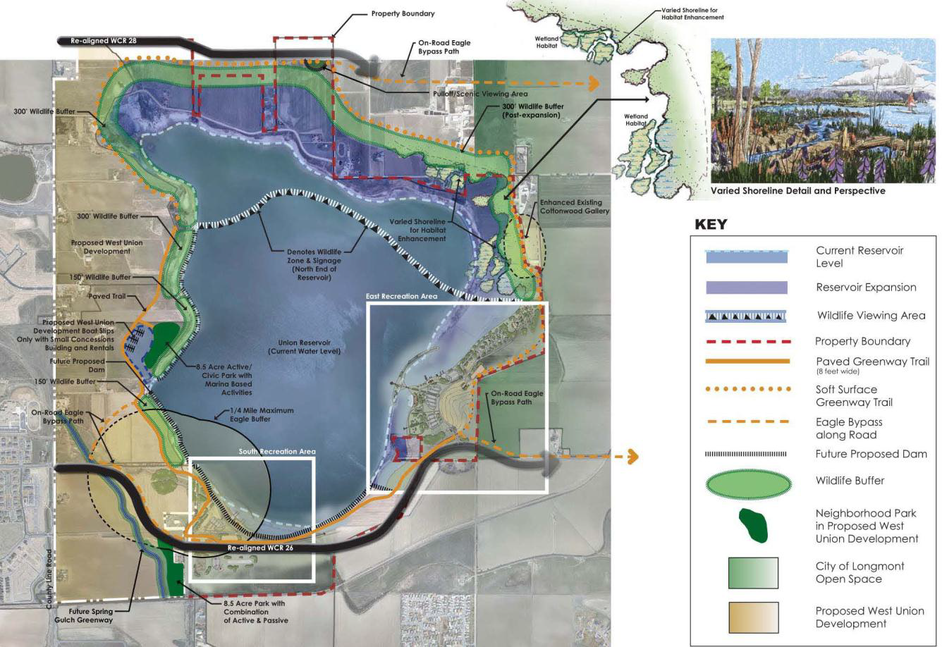
PRO010 Union Reservoir Recreation Improvements
Potential opportunity to pursue federal & other grant funding for Union Expansion

Slide 19
2023 CIP - LPC
Darrell Hahn

Slide 20
2023 LPC CIP – $8.4M, 13.1% of Total CIP
Notable Projects
Electric Grid Modernization - $375,000
Advanced Metering - $1,515,000
Electric System Capacity Increases - $1,693,515
AMI ramp

Slide 21

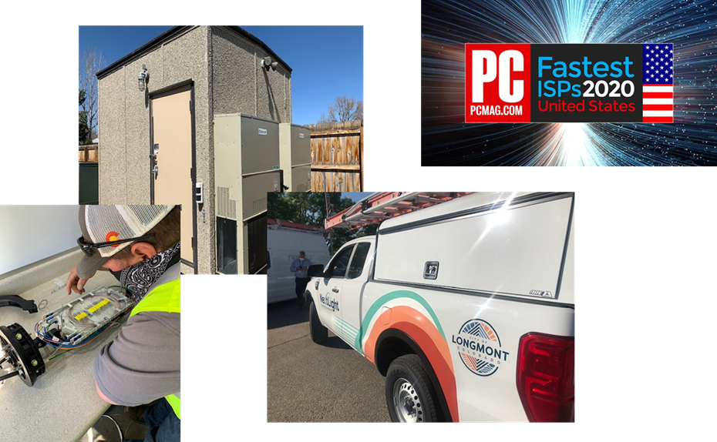
2023 CIP - NextLight
Focus on the following -
Network expansion
  Keep up with service demands
  Begin buildout of Phase 8
  Collocation and dark fiber leases
Network resilience
  Replace bad sections of aerial
    Aerial to underground conversions
  Rehab of City owned backbone
Network evolution
  Expansion to remaining phases for 10G
  Upgrade earlier phases
    Recover "wasted" fibers

Slide 22
2023 NextLight CIP – $3.7M, 5.8% of Total
Notable Projects
Backbone audit to recover fiber strands
Re-phasing areas to ensure coverage in future builds
Camera project in City parks and downtown corridor
Expansion to Phase 8 west of Longmont
6 City Projects represent 6% of CIP budget
$900K SVVSD
Planning for installs to ~3,000 new customers
New builds and new installs
Estimate 3,100 new apt units to be constructed

Slide 23

THANK YOU

