Slide 1
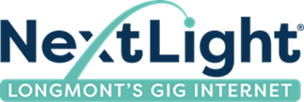
NextLight 2023 Budget Review
Sept 6 2022

Slide 2
Current Situation
Sales and revenue are steady but slowing
Have new services to promote
Comcast getting more aggressive with offers
Network is in good shape but outside plant and backbone need maintenance
Need to continue with network expansion plans to accommodate growth
Customer service expectations are growing

Slide 3
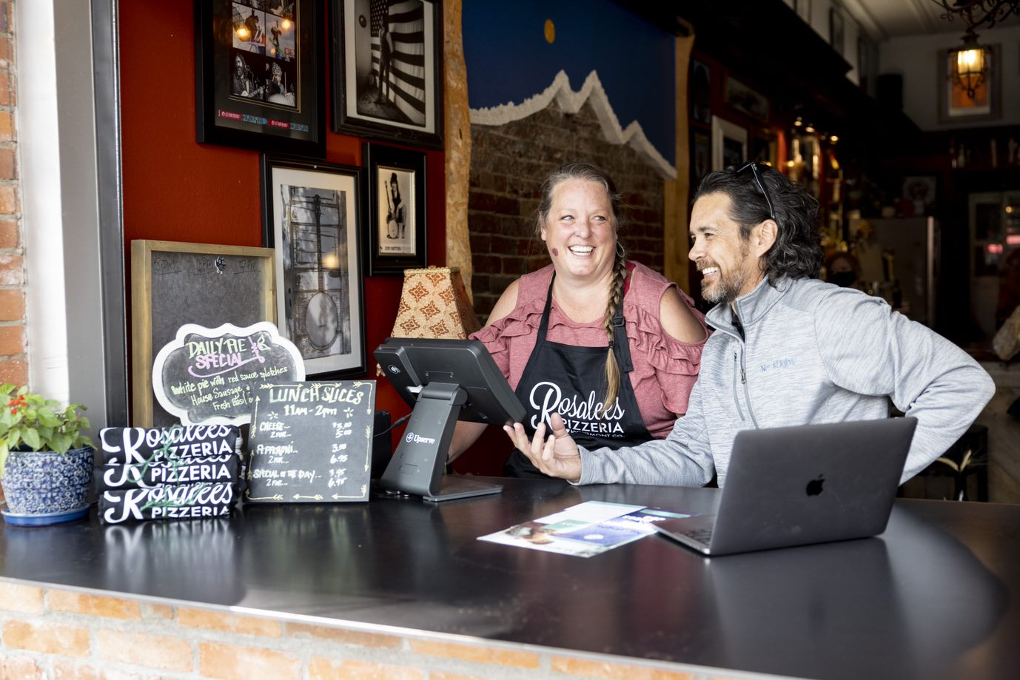
What’s Our Focus– Attract & Delight Customers
Executing on strategic sales & marketing plan with latest technology stack
Providing exceptionally fast and reliable internet
Being customer-centric with CRM foundation for favorable customer experience and competitive stance

Slide 4
How We Will Attract & Delight Customers
Strategic Sales & Marketing
Fast & Reliable Network
Customer Experience Focus
More brand advertising
Quarterly acquisition campaigns with incentives
Omni-channel marketing
Social media & content
Community engagement
IQ targeted efforts
Backbone fortification
Outside plant rehab
Undergrounding of aerial
Redundancy
Security/DDOS
10G support
Reclaimed fiber
Digital navigation FTE
Salesforce CRM integration
Enhanced sales training
Better online sign-up process
Manage and track customer touch points

Slide 5
What’s the Price Tag
Strategic Sales & Marketing
Fast & Reliable Network
Customer Experience Focus
$500K
$350K
$3-4M
More brand advertising
Quarterly acquisition campaigns with incentives
Omni-channel marketing
Social media & content
Community engagement
IQ targeted efforts
Backbone fortification
Bandwidth/capacity
Outside plant rehab
Undergrounding of aerial
Redundancy
Security/DDOS
10G support
Digital navigation FTE
Salesforce CRM integration
Enhanced sales training
Better online sign-up process
Manage and track customer touch points

Slide 6
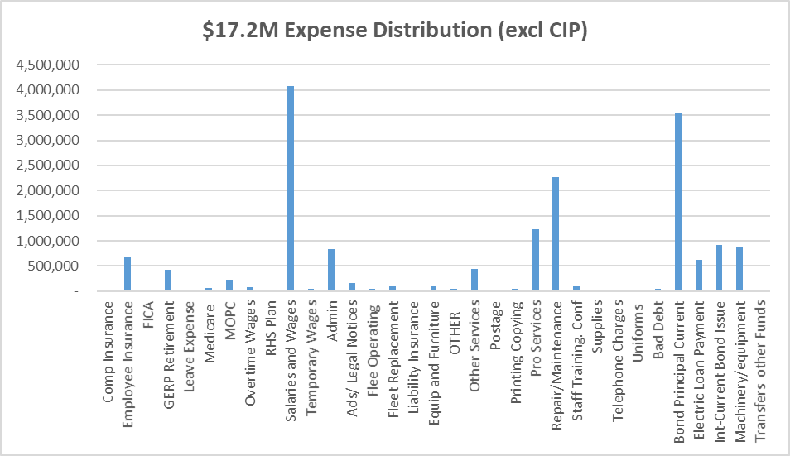
Where Else are We Spending Money
$5M debt payments
Personnel (33%)
Operating & Maintenance (32%)
Capital & Non Operating (35%)

Slide 7
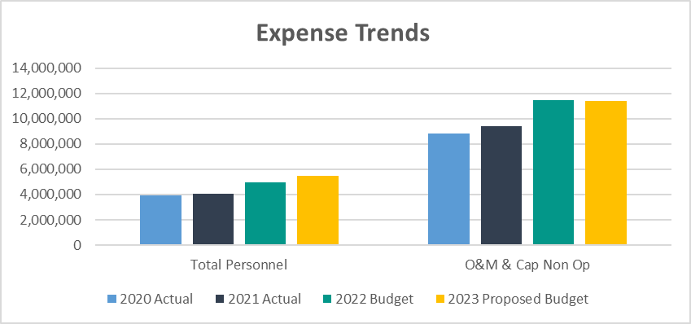
What are the Operating Expense Trends
Flat even with addition of CRM & more marketing
Salary increases & 1 FTE

Slide 8
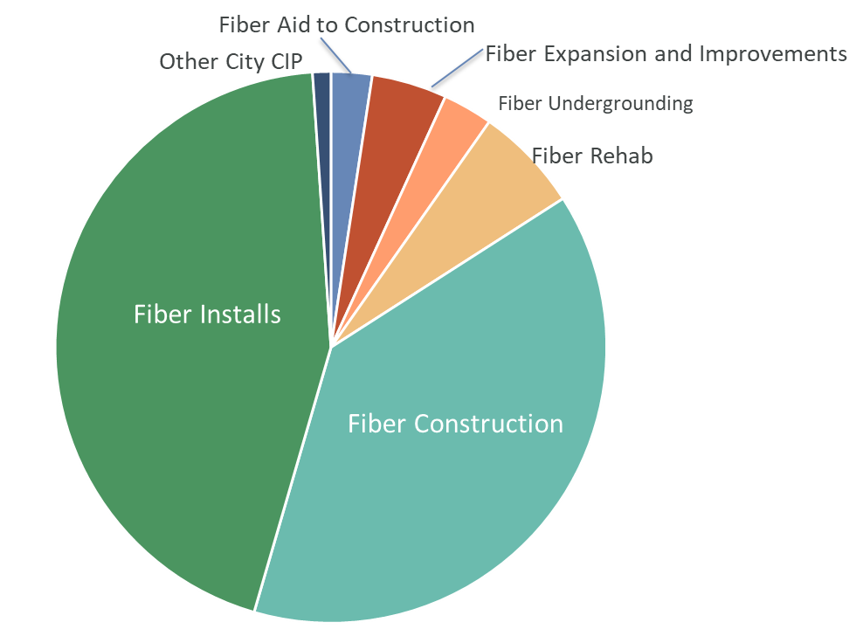
How are we Spending $3.7M in Capital
4,000 new installs to net 1,400
New SFU and 2100 new MDUs

Slide 9
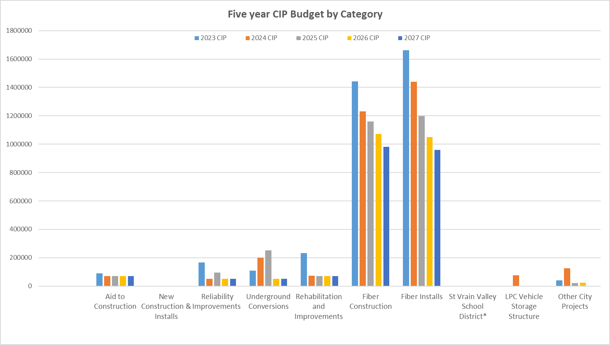
What are the CIP Expense Trends
Construction and new install cost declining as new builds slow

Slide 10
What Do We Get for our Investment

Slide 11
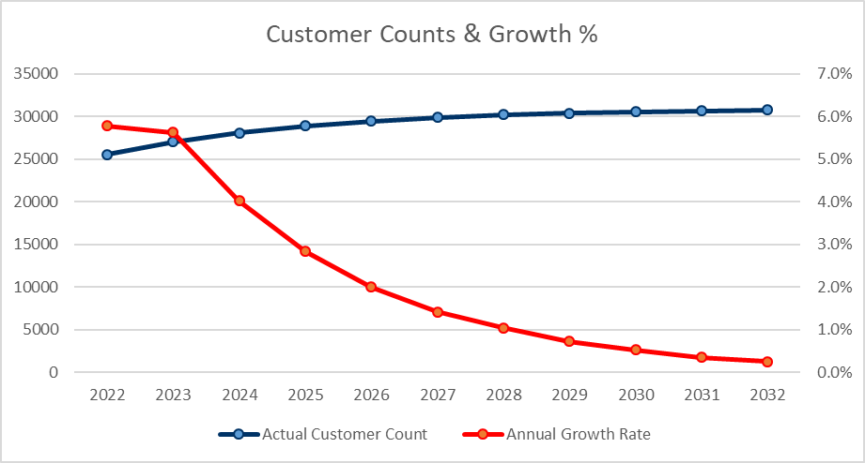
27,000 Customers
25,000 customers growing to 27,000
>1700 bulk MDU units in the pipeline
Revenue growing slower than customer count (3% v 5%)
New products and marketing to drive growth

Slide 12
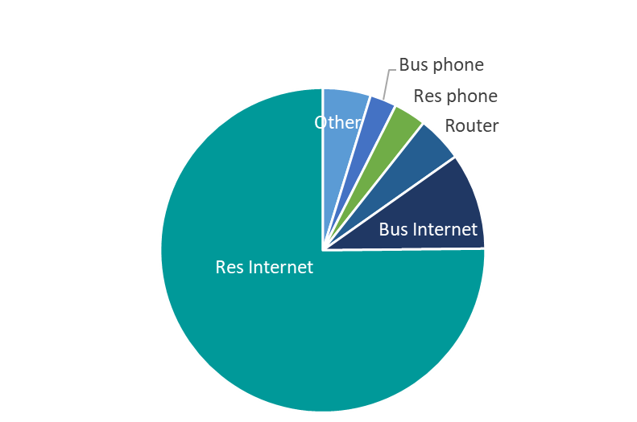
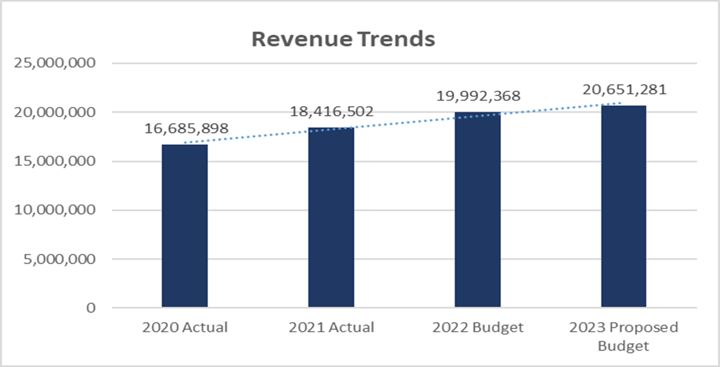
What Does Revenue Look Like
Vast majority of rev from 1Gig
Growth rate down from 8+% to 3%

Slide 13
The Combined View of Financials

Slide 14
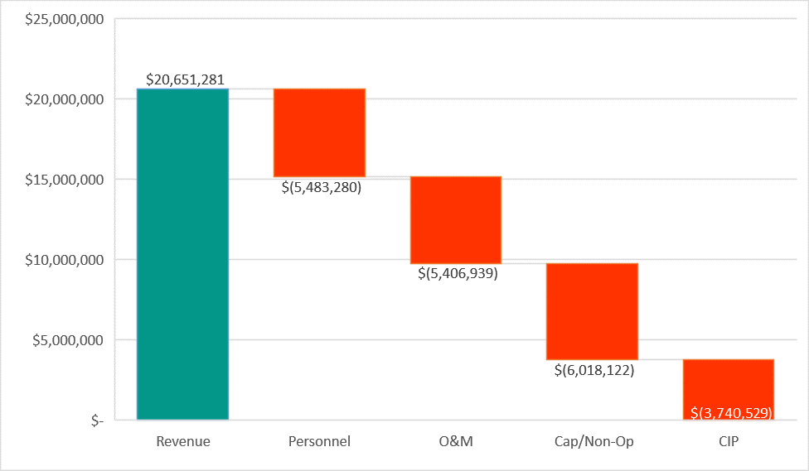
Revenue and Expense Waterfall Chart
Salaries
Network &
Marketing
$20.6M
Debt
Installs & Const

Slide 15
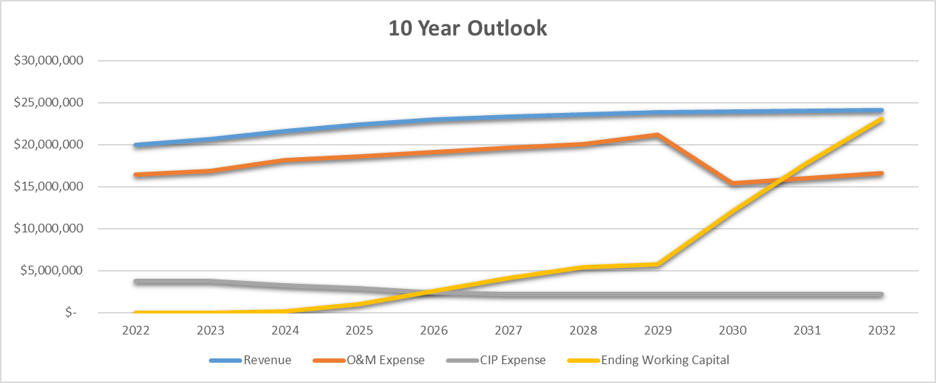
Financial Outlook
Revenue growth to slow & flatten out over time
Operating expense to drop materially after debt retired
Ending capital to grow dramatically after deb retired
CIP expense to decline over time

Slide 16
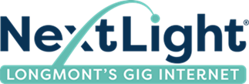
Budget Summary
Revenue and customer growth are looking favorable but slowing
Expenses are manageable and will decline in upcoming years yielding favorable margins
Debt pay-off on schedule leading to very high working capital in next 7-10 years
Taking necessary steps to future-proof network and to remain competitive

Slide 17
Questions?

