Slide 1

2023 PROPOSED BUDGET
SEPTEMBER 20, 2022

Slide 2
PRESENTATION TOPICS
New Positions in the Proposed 2023 Budget
Incremental Development Revenue
One Time Expenses
Attainable Housing
Affordable Housing
Human Service Agency Funding
Grants & External Funding Sources
LDDA Budget
Library Budget
Use of the Marijuana Tax
Longmont Public Media

Slide 3
2023 Budget PROPOSES 26.875 NEW FTE
TOTAL BUDGETED POSITIONS 1,097.65
13.125 in General Fund
8.0 in Public Safety Fund
1.54 in Water Fund
1.08 in Broadband
1.05 in Sanitation Fund
0.74 in Sewer Fund
0.75 in AIPP Fund
0.40 in Electric Fund
0.15 in Storm Drainage Fund
0.04 in Streets Fund

Slide 4
NEW POSITIONS
0.50 FTE Neighborhood Resource Specialist in Community and Neighborhood Resources from the General Fund - This position would help to support the Neighborhood Impact Team to coordinate and help this team function within the center of excellence/collective impact operations framework. It will problem solve neighborhood issues, develop strategic action and implement, gather data and track impacts.
One FTE Director of Human Services – This position will manage and supervise divisions that offer human services, human problem solving, and educational resources and services to Longmont community members. Divisions included are Children, Youth and Families, Senior Services, and unhoused resources including regional collaboration with Homeless Solutions for Boulder County. The position will administer the city’s human service funding process.

Slide 5
NEW POSITIONS
One FTE Librarian I in the Library for Children’s and Teen’s – This position is needed to both maintain services as well as to expand them. Librarians choose and order materials appropriate for age groups assigned, provide customer service assistance at service desks including recommending materials, designing, preparing and executing programs for children and teens, accept outreach requests from schools and community organizations, plan and provide timely displays, and assist parents & caregivers in navigation of educational databases and access to materials outside of open hours.
One FTE Recreation Program Coordinator in Recreation and Senior Services – This position would focus on increased and additional services for the intellectually and developmentally disabled community in Longmont. This position would be able to continue and enhance programs that include teen camp, Special Olympics teams, and dementia friendly recreation.

Slide 6
NEW POSITIONS
2.25 FTE Aquatic Facility Leads – These three 30 hour positions would replace some temporary Pool Managers. By replacing temporary Pool Manager shifts with benefitted Aquatic Facility Leads this will greatly reduce the number of temporary staff members needed and provide staff members more focused on longevity. Other advantages include routine schedules, increased safety, pump room competency, swim lesson program stability, and increased customer service.
One FTE Senior Assistant City Attorney – This position is needed to provide adequate legal support to the Longmont Housing Authority as well as support staff that deal with multi-faceted housing issues facing the City.

Slide 7
NEW POSITIONS
One FTE Custodial Supervisor in External Services from the General Fund – This position is needed to improve efficiency of the in house custodial staff and to provide consistent level of service and custodial processes throughout all locations.
One FTE Security Analyst in Enterprise Technology Services – The position would give the City more resources to devote to protecting City systems and devices from ever-increasing cybersecurity threats.

Slide 8
NEW POSITIONS
One FTE Senior Customer Service Representative in Utility Billing – The position is needed to assist customers who are struggling to pay their bills. It will act as a point of contact helping these customers to find assistance to help pay their bills. It will work in conjunction with other areas of the City which are also involved in helping customers in need such as Community Services as well as external organizations such as the OUR Center.
0.375 FTE Customer Service Representative in Utility Billing – This increases will raise a part time benefitted position to a full time status. The position serves as a backup to the Mail Room operation and is also involved in the billing processes. It will provide us more resources to provide daily customer support to serve an increasing customer count and increasing programs.

Slide 9
NEW POSITIONS
One FTE Human Resources Coordinator in Shared Services – This position is needed to strengthen our recruiting efforts in a very competitive hiring environment. This position will work with established community internship programs, coordinate between city departments for volunteers, and help to make our pre-employment process more efficient.
One FTE Procurement Specialist in Purchasing – This position will negotiate acceptable terms and conditions for contracts that are not the result of a solicitation process, assist with contract administration issues, and assist with regular reviews of standard terms and conditions as well as contract clauses.

Slide 10
NEW POSITIONS
One FTE Financial Analyst in Finance – This position would assist with analysis of financial transactions for special finance projects, for additional Munis functionality, and for major Munis upgrades. The position will also assume tasks from the CFO including review and analysis of bonded capital projects, tax increment funded efforts, economic incentives, self-insurance funds, special funding districts, tax rebate programs and continuing disclosure for city debt issues.
One FTE Clinician III in Community Health & Resilience from the Public Safety Fund. – This position is part of the CORE Team and responds to calls for service involving individuals with mental health needs or issues. A 4th CORE Team is being added in the proposed 2023 budget to help manage increasing crime and calls for service.

Slide 11
NEW POSITIONS
One FTE Co-Responder Paramedic in Community Health & Resilience from the Public Safety Fund – This position is part of the CORE Team and responds to calls for service involving individuals with mental health needs or issues. A 4th CORE Team is being added in the proposed 2023 budget to help manage increasing crime and calls for service.
One FTE Police Officer in Community Health & Resilience from the Public Safety Fund – This position is part of the CORE Team and responds to calls for service involving individuals with mental health needs or issues. A 4th CORE Team is being added in the proposed 2023 budget to help manage increasing crime and calls for service.

Slide 12
NEW POSITIONS
One FTE Victim Advocate in Community Health & Resilience from the Public Safety Fund – This position is needed to increase our current Victim Advocate program which responds to victims of crime and/or unexpected tragedy. Under the Victim Rights Act we will need to add weekend coverage and provide services for additional crimes.
One FTE Communications Shift Supervisor in Communications from the Public Safety Fund – This position is needed to provide full supervisory coverage to the Communication division which is a 24x7 operation. It will supervise assigned shifts, participate in activities related to the goals and operation of the Communications Center, and assist with on call duties as needed.

Slide 13
NEW POSITIONS
Three FTE Firefighters in Fire from the Public Safety Fund – These positions are needed to help maintain minimum staffing levels due to vacancies and the lack of buffer between available vacation slots and minimum staffing.
One FTE Public Works Technician II in Public Works and Natural Resources from the Sanitation Fund – With growth in the number of solid waste customers along with staffing challenges from absences, turnover and an inability to hire temporary labor this position is intended to help relieve those pressures.
One FTE Water Utility Technician Lead in Public Works and Natural Resources from the Water Fund – This position is needed to help respond to a significant increase in work orders due to the passage by the State of the new 811 locate rules.

Slide 14
NEW POSITIONS
One FTE Water Quality Analyst I in Public Works and Natural Resources from the Water Fund, the Sewer Fund, and the Storm Drainage Fund – This position is needed to respond to increased workloads in the laboratory due to new and existing regulations. It will provide specialized instrumental analysis, quality systems support, assure EPA quality assurance/quality control and develop redundancy within the Quality Systems program.
One FTE Administrative Assistant in Public Works and Natural Resources from the Electric Fund, the Broadband Fund, the Water Fund, the Sewer Fund, the Storm Drainage Fund, the Sanitation Fund, and the Streets Fund – This position will assist the Strategic Integration admin team with efforts such as monitoring backflow, SOP updates, ordering supplies, processing purchase orders, receiving invoices, and maintaining a high level of internal and external customer service.

Slide 15
NEW POSITIONS
One FTE Digital Navigation Manager in Broadband - The position is needed in the Customer Operations Division to meet the needs of the Smart Cities initiative and in home digital navigation and enablement.
0.75 FTE AIPP Program Assistant from the Art in Public Places Fund – This position will provide additional resources so that the AIPP program can sufficiently plan for the expenditure of funds earmarked for AIPP.

Slide 16
INCREMENTAL DEVELOPMENT REVENUE
Financial Policy – revenue above base of 200 new dwelling units is considered incremental development revenue (IDR)
2023 Proposed budget incudes projection of 800 building permits for new dwelling units
Total IDR $ 468,903
  $ 420,706 building permits
  $ 48,197 plan reviews

Slide 17
INCREMENTAL DEVELOPMENT REVENUE

Slide 18
PROPOSED ONE-TIME EXPENSES
GENERAL FUND
Total $ 5,411,621
One Time Revenues $ 426,135
  Tree Mitigation Fees (EAB) 30,000
  Union Reservoir Fees 62,500
  Oil and Gas Royalties 60,000
  Transfers from Other Funds 273,635
Net One-time Expenses $ 4,985,486

Slide 19
PROPOSED ONE-TIME EXPENSES
GENERAL FUND (continued)
Capital – Equipment $ 1,739,559
IT Equip/Technology Improvements 771,755
Non-Cap Small Equip & Supplies 195,992
One Time Services or Expenses 2,704,315

Slide 20
PROPOSED ONE-TIME EXPENSES
PUBLIC SAFETY FUND
Total $912,393
Capital – Equipment $ 558,000
IT Equip/Technology Improvements 98,067
Non-Cap Small Equip & Supplies 53,734
One Time Services or Expenses 61,592
PBF109 Parking Lot Rehabilitation 141,000

Slide 21
PROPOSED ONE-TIME EXPENSES
OTHER FUNDS
Total $1,917,973
Capital – Equipment $1,050,000
IT Equip/Technology Improvements 241,315
Non-Cap Small Equip & Supplies 36,658
One Time Services or Expenses 590,000

Slide 22
ATTAINABLE HOUSING
$250,000 per year ongoing General Fund transfer to create an Attainable Housing Fund
$700,000 of one-time funding for a total 2023 commitment of $950,000

Slide 23
AFFORDABLE HOUSING
No changes to 2022 request for Affordable Housing Fund:
  $1M ongoing general fund transfer
  50% of Marijuana sales tax revenue ($290k)
  Administration
    10% of all revenues to AHF (general fund, Marijuana tax, fee-in-lieu, program income)
    $206,543 general fund transfer

Slide 24
HUMAN SERVICE AGENCY FUNDING
The 3% set aside for human services was met with the 2022 budget. The increase for 2023 of $171,537 is due to the increase in the overall budget for taxes.
2023 funding for human services is $2,468,850
Assists low-moderate income Longmont residents in meeting their basic physical, social, economic and/or emotional well-being needs.
2023 Funding Applications were due on September 9th. This year the City received 41 program applications for 37 agencies for nearly $2.2 million dollars.

Slide 25
The Bipartisan infrastructure law (BIL) & the inflation reduction act (IRA)

Slide 26
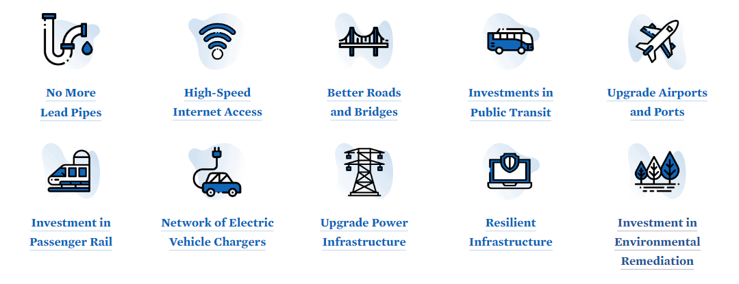
BIPARTISAN INFRASTRUCURE LAW RECAP
The Bipartisan Infrastructure Law includes funding to:
Rebuild roads, bridges and rails
Expand access to clean drinking water
Increase access to high-speed internet
Tackle the climate crisis
Advance environmental equity
Improve our nation’s ports, airports, rail, and roads.

Slide 27
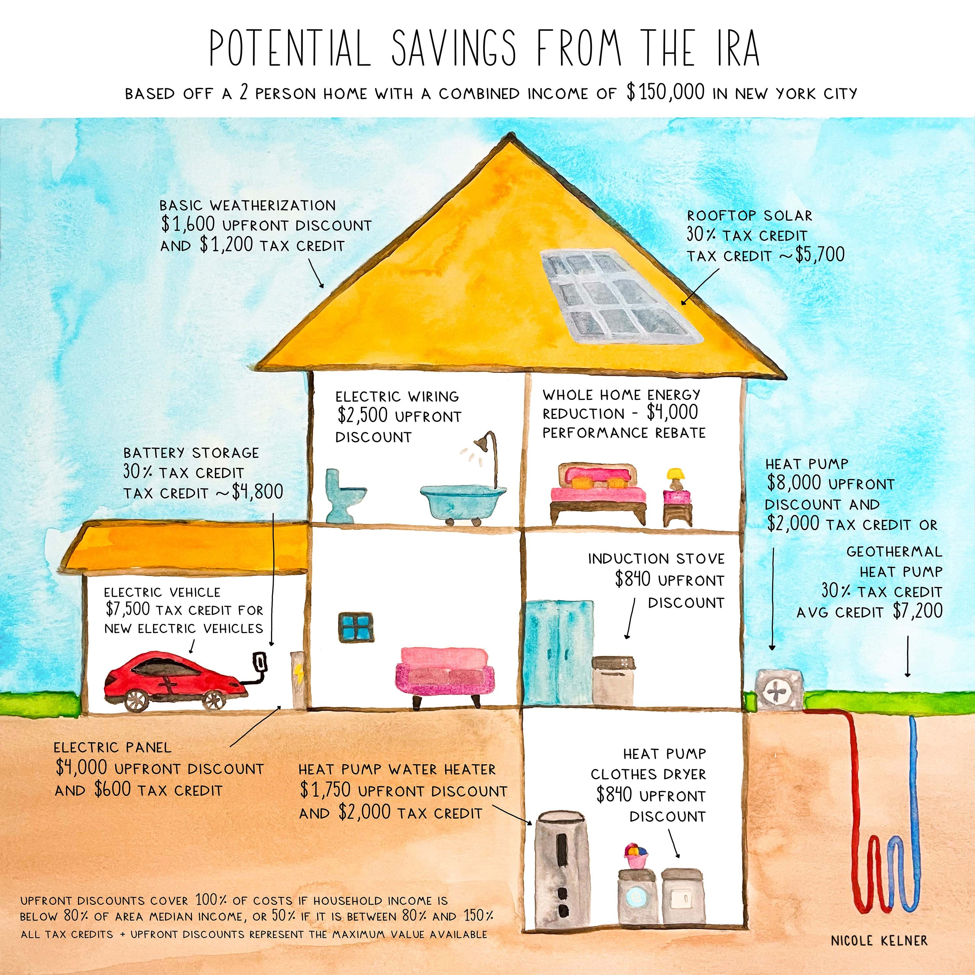
INFLATION REDUCTION ACT
This bill will provide a range of incentives to consumers to relieve the high costs of energy and decrease utility bills.
Consumer home energy rebate programs, focused on low-income consumers, to electrify home appliances and for energy efficient retrofits.
Consumer tax credits to make homes energy efficient and run-on clean energy, making heat pumps, rooftop solar, electric HVAC and water heaters more affordable.
$4,000 consumer tax credit for lower/middle income individuals to buy used clean vehicles, and up to $7,500 tax credit to buy new clean vehicles.
1-billion-dollar grant program to make affordable housing more energy efficient.

Slide 28
Identifying & applying for grants

Slide 29
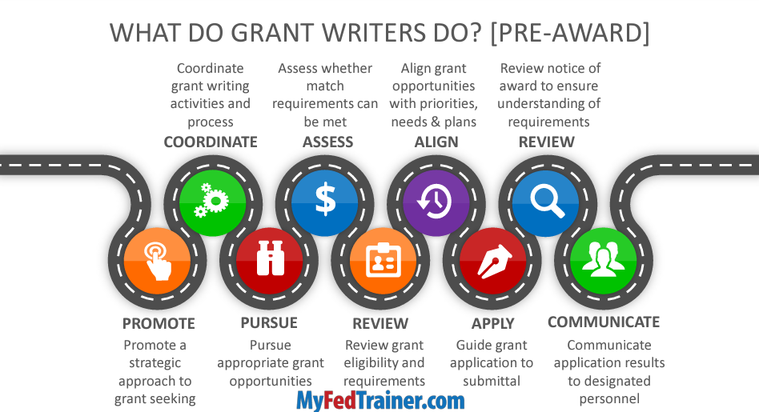
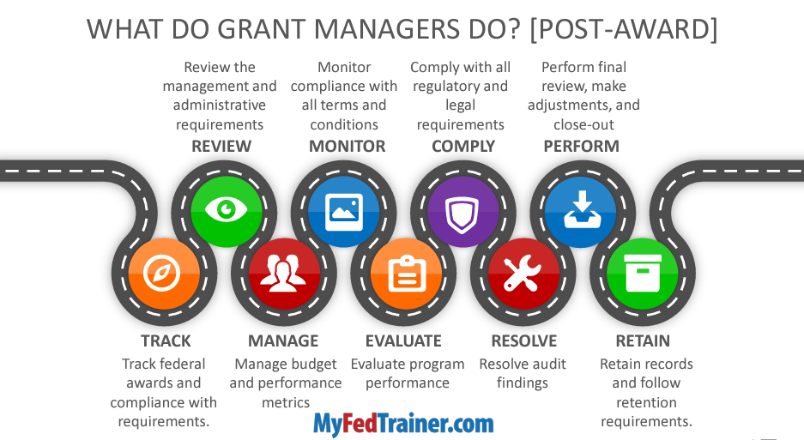
GRANT COORDINATION/MANAGEMENT
Pre-Award
Post-Award

Slide 30
GRANT
COORIDINATION/
MANAGEMENT
Goal/Objective Assignment | Coordinate with Department Directors to establish grant funding goals (What is the Vision, are the Strategic Goals, Alignment to Envision/Council Initiatives, etc.).
Grant Discovery | Search grant sources and alert Directors/Project Managers, when applicable grant opportunities that match our CIP, Strategic Goals, Action Plans, etc., appear.
Proposal Form & Analysis | Department/Division staff complete Grant Proposal Form and meet with Grant Coordinator and/or possible stakeholders to determine viability of grant success.
Grant Cycle Communication | Assign grant-related tasks/criteria to stakeholders/work groups or individuals (set up deadline notification & communication pipeline procedure(s).
Pipeline Management | Submit grant applications/proposals and track their progress.
Document management | Store letters of intent/applications/proposals and forms in a central and searchable repository SharePoint Site or Grant Management System (there is a Grant Management tab in Munis/Tyler Systems – but it is not activated and more than likely is from the financial/budget tracking side only). Maintain a library of common responses and attachments to use in future grant applications.
Compliance management | Monitor ongoing grant requirements (Are we in compliance? Invoicing, status reports, etc. Are there connecting pieces in other Divisions/Departments, etc.?).
Financial reporting | Analyze grant award percentages and how much funding and reimbursements we are receiving (can track in Munis against the individual/group budget/invoicing in division(s)/department(s).

Slide 31
THINGS TO CONSIDER…
Political and/or community sentiment, environmental conditions, etc..
Risk Analysis
Available resources, alignment with strategic goals/action plans, etc.
Cost-Benefit Analysis
Pre and Post Award requirements
Operational Analysis
Matching fund ability, funded/unfunded projects, etc.
Cost-Effectiveness Analysis
Notes:
Did you want to mention volunteers? To help research, etc?

Slide 32
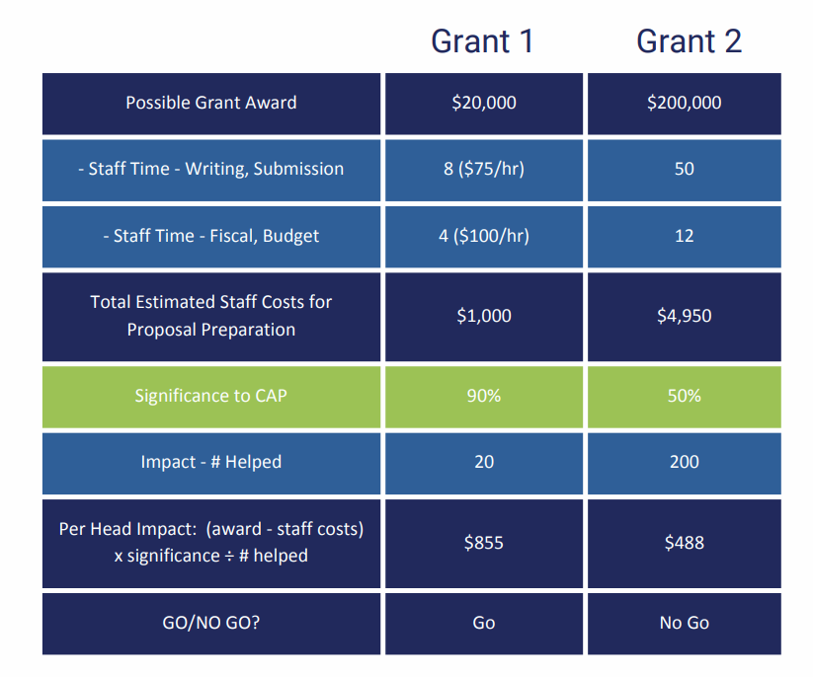

Example of a Selection Go/No Go Matrix
Alignment to CIP

Slide 33
SUSTAINABILITY TAX FUNDING

Slide 34
PROPOSED 2023 PROJECTS
Climate Risk and Vulnerability Recommendations
Building Electrification Recommendations
Zero Waste Opportunities

Slide 35
LDDA BUDGET
Longmont General Improvement District
Downtown Parking Fund
LDDA Funds

Slide 36
LONGMONT GENERAL IMPROVEMENT DISTRICT
Budget of $164,039 for 2023
Increase of $14,875 over 2022
$14,875 increase in personal services
$2,186 decrease in O&M (mtc & cleaning)
$6,456 decrease in ATF to City

Slide 37
DOWNTOWN PARKING FUND
Budget of $115,792 for 2023
Increase of $16,220 over 2022
$11k increase in personal services
$5k increase in O&M

Slide 38
LDDA OPERATING FUND
Budget of $377,763 for 2023
Increase of $50,744 over 2022
73% of the increase is in personal services
$12,510 increase in O&M

Slide 39
LDDA DEBT SERVICE FUND
TIF Budgeted at $1,312,375 for 2023
August valuations project over $1.6 million
$380,865 to fund Arts & Entertainment
$545,475 to fund Construction Fund projects

Slide 40
LDDA ARTS & ENTERTAINMENT FUND
Budget of $446,865 for 2023
Increase of $33,061 over 2022
$20k increase in personal services
$24k increase in contract serv for events
$10k decrease in advertising & legal notices
TIF funding of $380,865 in 2023

Slide 41
LDDA CONSTRUCTION FUND
Projects $171,000
Project management 20,840
Infrastructure replacement 62,035
CIP projects 350,000
Total Construction Fund budget $603,875

Slide 42
LDDA CONSTRUCTION FUND - PROJECTS
Placer AI data service $12,000
Pedestrian metrics 3,500
Mural/cultural project 15,000
Parking study update 50,000
Parklet maintenance 15,500
Economic vitality 25,000
Spoke garage O&M & lease 50,000

Slide 43
LDDA CONSTRUCTION FUND – CIP PROJECTS
TRP137 Main Street Corridor Plan $250,000
DTR008 Downtown Alley Improvements $100,000

Slide 44
LIBRARY BUDGET
Level 1 requests:
  Increase in annual fees for Library Consortium - $7,029
  Minimum wage increase for Library Shelvers - $25,004
Level 2 requests:
  FTE Librarian I - Children’s and Teens
  Temp wages for a 20-hour Library Assistant for Materials Processing - $20,214
  Temp wages for 2-PTNB 20-hour Library Assistant for Computer Lab - $40,414
  PTNB and Temp staff to 101% of midpoint for all areas - $32,732
One Time requests:
  Xerox printers - $12,000
  Additional monitors for staff who have requested two monitors - $5,000
Recommendation to eliminate Library Fines - $35,000 Reduction in Revenue

Slide 45
2023 USE OF THE MARIJUANA TAX
  2023 projected tax revenue is $580,000
  2023 proposed budget includes $290,000 for Affordable Housing & $290,000 for Mental Health & Addiction

Slide 46
LONGMONT PUBLIC MEDIA
Options
  Similar level of service
    152,500 ongoing from 25% of cable franchise ($12,500 more than 2022)
    120,000 one time which is available in the proposed 2023 budget
  Reduced level of service
    At 25% of current budgeted revenues of $152,500
  Bring public access media service in-house
  Bid public access media services competitively

Slide 47

Other questions, comments or additional information needed?

