Slide 1

2023 PROPOSED BUDGET
SEPTEMBER 27, 2022

Slide 2
PRESENTATION TOPICS
Items delayed from September 20
  Early Childhood Capacity Building
  529 Jump
  Supporting Actions for Mental Health
Priority Based Budgeting and the 2023 Budget
Financial Policies
Public Safety Take Home Vehicle Program
Public Hearing

Slide 3
Early childhood capacity building
529 Jump
Supporting actions for mental health

Slide 4


EARLY CHILDHOOD EDUCATION
EARLY CHILDHOOD (EC) CAPACITY BUILDING
CHILDREN, YOUTH AND FAMILIES
$400,000 ONE TIME; $100,00 ONGOING
Support Design & Development of an EC Community Hub (HUB) focused on serving children ages 0-5.
HUB would bring together in one facility:
Professional development and training opportunities for early care providers, especially Family, Friend and Neighbor (FFN) caregivers, high quality and culturally/linguistically matched early childhood care and education
Medical, social-emotional, language support for families and professional
Peer/community support for providers and families

Slide 5
EARLY CHILDHOOD EDUCATION
EARLY CHILDHOOD (EC) CAPACITY BUILDING (Continued)
CHILDREN, YOUTH AND FAMILIES
$400,000 ONE TIME; $100,00 ONGOING
Support one-time funding for capacity building
Strengthen the EC system and support the 3 areas addressed in HUB model.
$100,000 of ongoing funds earmarked to offset cost and designate spots for interested City of Longmont employees to obtain care for their children through HUB.

Slide 6
EARLY CHILDHOOD EDUCATION
529 Jump Program
CHILDREN, YOUTH AND FAMILIES
$25,000 Ongoing Funding
529 Jump: A community program that designed to bring awareness to saving for post-secondary education by utilizing a tax-deducting 529 savings account
75% of jobs in Colorado require a college degree and investing in the class of 2036's education ensures we have skilled workers, volunteers, and voters in our future
Partnership between City of Longmont, St. Vrain Valley Schools, St. Vrain Education Foundation (Fiscal Agent)

Slide 7
EARLY CHILDHOOD EDUCATION
529 Jump Program (Continued)
CHILDREN, YOUTH AND FAMILIES
$25,000 Ongoing Funding
Each Kindergarten student in St. Vrain Valley School District is able to set up a 529 college saving account, showing them that the City of Longmont believes in their future and supports them in their education efforts
Post Pandemic Efforts to Bring Other Municipalities On Board
Utilizing Cultural Broker Lens Expertise
Expansion for up to 3rd Grade

Slide 8
MENTAL HEALTH
SUPPORTING ACTION FOR MENTAL HEALTH (SAM)
CHILDREN, YOUTH AND FAMILIES
$290,000
Council directed the non-earmarked 50% of the Special Marijuana Sales Tax to be used for mental health and addiction
In 2023, $290,000 from this source proposed for outreach and therapeutic services: services that would support unhoused community members
Effects of the Pandemic on Mental Health
  Concerns about mental health and substance use grew
  Including concerns about suicidal ideation
  Nationwide, in 2021, 41% of adults reported symptoms of anxiety and/or depressive disorder

Slide 9
MENTAL HEALTH
SUPPORTING ACTION FOR MENTAL HEALTH (SAM)
(Continued)
CHILDREN, YOUTH AND FAMILIES
$290,000
City of Longmont Response
  Virtual mental health conference in December of 2021
  De-escalation training, by Ryan Dowd
  Training on the impacts of secondary trauma for employees from CYF, Senior Services, Community & Neighborhood Resources and Longmont Housing
  Convene SAM taskforce again and begin to leverage Mental Health and Addiction work that is occurring community-wide

Slide 10
Priority based budgeting and the 2023 budget

Slide 11
PRIORITY BASED BUDGETING AND THE 2023 BUDGET
Brief Overview of the Process
  Identify the Right Result
  Define and Value the Results
    Livable centers, corridors and neighborhoods 17.1%
    A complete, balanced and connected transportation system 12.2%
    Housing, services, amenities, and opportunities for all 20.3%
    A safe, healthy, and adaptable community 17.7%
    Responsible stewardship of our resources 16.0%
    Job growth and economic vitality through innovation and collaboration 16.7%
  Score the City’s Programs
  End with a prioritized list of City Services

Slide 12
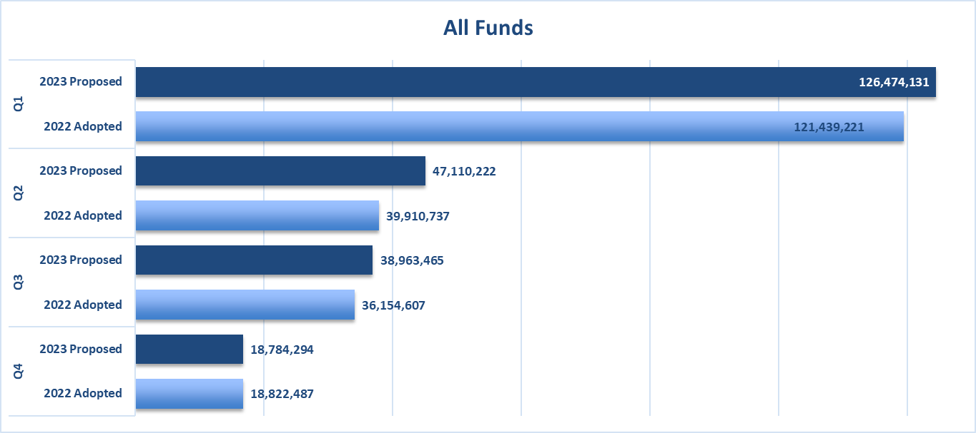
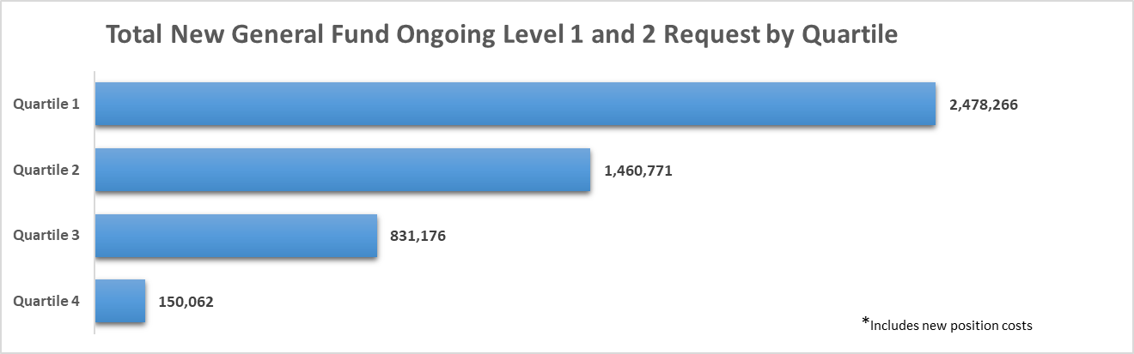
PBB QUARTILES
2023 Proposed Budget vs 2022 Adopted Budget – All Funds
2023 General Fund ongoing requests

Slide 13
OPEN PBB DATA
Public Access to our PBB Data
https://www.longmontcolorado.gov/departments/departments-e-m/finance/budget-office/budget-prioritization

Slide 14
INCLUDING EQUITY IN PBB
Step 1 completed for the 2022 Budget
Created equity insights – information for each program based on Equity Team’s definitions of equity components
Step 2 completed for the 2023 Budget
Turned these equity insights into a Basic Program Attribute scoring component
Notes:
Last year Council gave us direction to include equity into our Priority Based budgeting process. We asked the question how can this be represented in the PBB model. We can not provide services without resources. We want to show how resource allocation supports equity.

Slide 15
ONGOING LEVEL 1 REQUESTS BY QUARTILE-EQUITY SCORE
We wanted to share how the funded requests supported Equity and City priorities
  Quartiles are represented as a score of 1 being most aligned with City priorities and a 4 being least aligned
  Equity scores are represented as a 4 being the highest score received and a 0 is the lowest score received
Top graph represents all ongoing level 1 requests in relation to Quartile and Equity score
Bottom graph represents just the ongoing level 1 requests in the General and Public Safety Funds by Quartile and Equity Score
  The highest desired score a program could receive is a 1-4
  Highlighted in green are the dollars in the highest scored quartile to equity component
  Highlighted in red are the least desirable

Slide 16
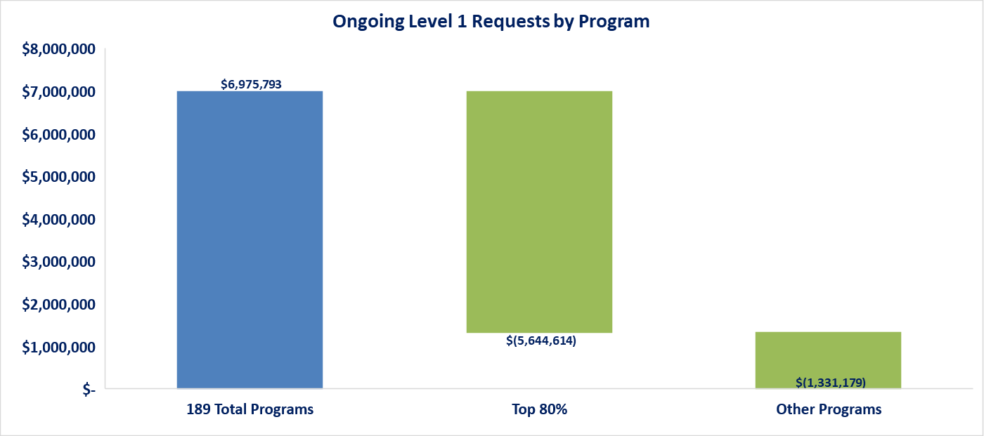
ONGOING LEVEL 1 REQUESTS BY PROGRAM
Potable & Raw Water Service (Q1-E2)
Fuel Management (Q3-E2)
Residential waste diversion and collection (Q1-E3)
Utilities (Q2-E2)
Oil and Gas Coordination (Q1-E2)
Landscape and hardscape maintenance for parks, greenways, right-of-ways, and city facilities (Q1-E2)
Security Systems(Q1-E2)
Training(Q1-E2)
Sewer Collection and Wastewater Treatment (Q1-E2)
Transportation Maintenance and Repair (Q1-E3)
Recreation Center – Programs, Events and Services (Q2-E2)
Total ongoing Level 1 requests received amount to $6.9million which fall in 189 programs
11 programs make up 80% of level 1 requests

Slide 17
ONGOING LEVEL 2 FTE REQUESTS BY QUARTILE-EQUITY SCORE
  Highlighted in green are the FTE in the highest scored quartile to equity component
    There are 13.57 FTE that fell in these highest ranked programs
      Director of Human Services
      Art in Public Places Program Assistant
      Neighborhood Resource Specialist
      Children’s Librarian 1
      Therapeutic Recreation Coordinator
      HR Coordinator
      Public Works Technician II
      Administrative Assistant
      Digital Navigation Manager
      Communications Shift Supervisor
      3 Firefighters
      Outreach Victim Advocate
      CORE Team personnel (Police Officer, Clinician, Paramedic)
  Highlighted in red are the FTE in the lowest scored quartile to equity component
    There are 0.67 FTE that fell in the lowest ranked programs
      Senior Customer Service Representative
      Customer Service Representative

Slide 18
ONE TIME REQUESTS BY QUARTILE-EQUITY SCORE
How funded requests support Equity and City priorities
  Quartiles are represented as a score of 1 being most aligned with City priorities and a 4 being least aligned
  Equity scores are represented as a 4 being the highest score received and a 0 is the lowest score received
Top graph represents all one time requests in relation to Quartile and Equity score
Bottom graph represents just the one time requests in the General and Public Safety Funds by Quartile and Equity Score
  The highest desired score a program could receive is a 1-4
  Highlighted in green are the dollars in the highest scored quartile to equity component
  Highlighted in red are the least desirable

Slide 19
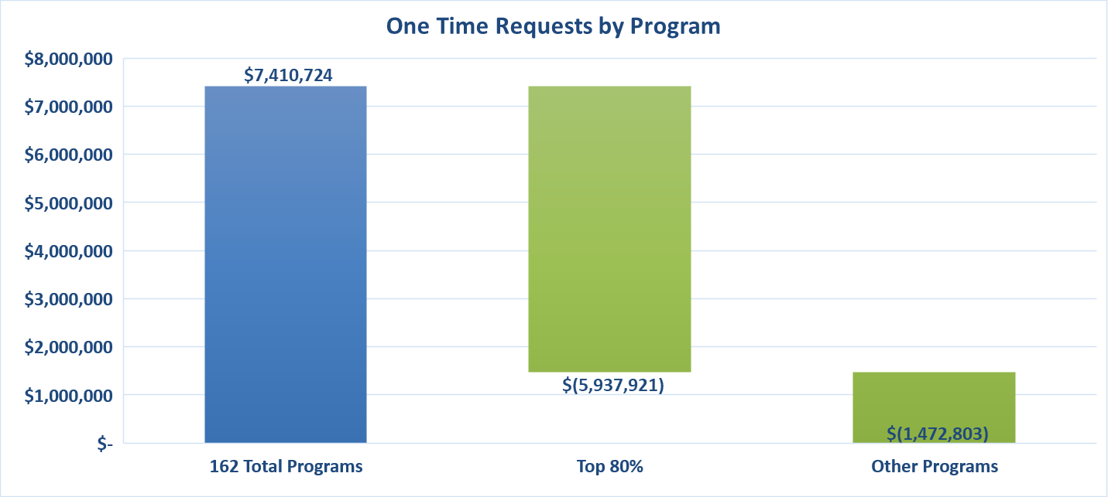
ONE TIME REQUESTS BY PROGRAM
Proactive Patrol (Q1-E3)
Network Reliability (Q1-E0)
Citywide Projects Support CMO (Q1-E2)
Residential waste diversion and collection (Q1-E3)
Potable and Raw Water Service (Q1-E2)
Risk Management (Q2-E3)
Technical/Regulatory Support (Q1-E2)
Sustainability (Q1-E3)
Collaborative Service Coordination Internal (Q3-E3)
Landscape and hardscape maintenance for parks (Q1-E2)
Applications (Q1-E1)
Video Services/Channel 8 Cable Trust (Q3-E2)
Information Technology (Q2-E2)
Development Services-Redevelopment (Q3-E2)
Property and Evidence (Q2-E1)
Health and Safety Codes Enforcement (Q1-E3)
Electric Service Provision (Q1-E3)
Storm water Operations & Maintenance (Q1-E3)
Total one time requests received amount to $7.4 million which fall in 162 programs
20 programs make up 80% of one time requests

Slide 20
Financial policies

Slide 21
FINANCIAL POLICIES
Reviewed by staff annually as part of the budget process
Adopted by resolution, October 25
Effective January 1, 2023

Slide 22
NEW POLICY
Procurement Thresholds
The City will use methods of procurement for City goods, services, and construction in compliance with thresholds as defined in the Purchasing Code (LMC 4.12). The thresholds include (1) micro, for which vendor selection is at the discretion of the end user, (2) small, for which vendor selection requires solicitation of a minimum of three documented quotations, and (3) formal, for which vendor selection requires a formal/sealed competitive solicitation of bids or proposals. The dollar amount for each threshold is included in the Financial Policies for annual review and adjustment as appropriate.
Standard procurement thresholds:
Micro: up to $10,000
Small: up to $250,000
Formal: over $250,000
Procurements valued between $10,000 and $250,000 require solicitation of a minimum of three competitive, documented quotes conforming to the requirements of LMC 4.12, using a sourcing and evaluation method which must be approved by central professional procurement staff prior to issuance of an award.
The City will amend LMC 4.12 in 2023 to (1) remove references to specific dollar amounts attributed to each threshold and (2) update terminology to differentiate between micro and small purchases.

Slide 23
UPDATED POLICIES
Public, Educational, and Governmental (PEG) Access Television Services
25% 50% of the General Fund’s budgeted cable television franchise revenues will be allocated for the purposes of providing public, educational, and governmental television services in 2023 and 2024. If the actual cable television franchise revenue collected by the City is greater than ten percent (10%) less than the City’s General Fund’s budgeted cable television franchise revenues, then the contract price shall be twenty-five fifty percent (25 50%) of the actual cable television franchise revenue collected by the City.
The 2022 Operating Budget includes $140,000 for a contract for service with Longmont Public Media. In addition Council approved an additional $120,000 of one time funding for the contract with Longmont Public Media for 2022. [TO BE UPDATED AFTER THE 2023 BUDGET IS COMPLETE]

Slide 24
UPDATED POLICIES
Health Benefits Fund
The City will maintain an insurance fund for the payment of health care costs under the terms of the plan document. This will include, but not be limited to, insurance and premiums, administration, and consulting fees. The City will follow a policy of fully funding the expected costs of the fund with a combination of City and employee contributions.
The City currently maintains such a fund. It is funded with contributions from the City’s operating funds and premium contributions from employees and retirees. In addition to medical care costs, the fund will continue for the purpose of dental, vision, long term disability, life insurance, other post-employment benefits public safety physicals and counseling costs, and the City’s wellness program costs. The City switched to a fully insured medical plan at 1/1/07. The City switched to a fully insured dental plan at 1/1/13.

Slide 25
UPDATED POLICIES
Special Marijuana Sales Tax
One-half of the sales tax collected in the Special Marijuana Sales Tax Fund will be transferred annually to the Affordable Housing Fund. The other one-half will be allocated for use as per Council direction during the annual budget process. The other one-half will be transferred annually to the General Fund to be used for mental health and addiction programs.
The City currently follows this policy.

Slide 26
Public safety take home vehicle program (THVP)

Slide 27
TAKE HOME VEHICLE PLAN
Benefits
“INVALUABLE”, “A FORCE MULTIPLIER”, “PRICELESS”, AND A “MORALE BOOSTER”
RECRUITMENT AND RETENTION
THE SAFETY OF OUR CITIZENS AND STAFF
INCREASED ACCOUNTABILITY

Slide 28
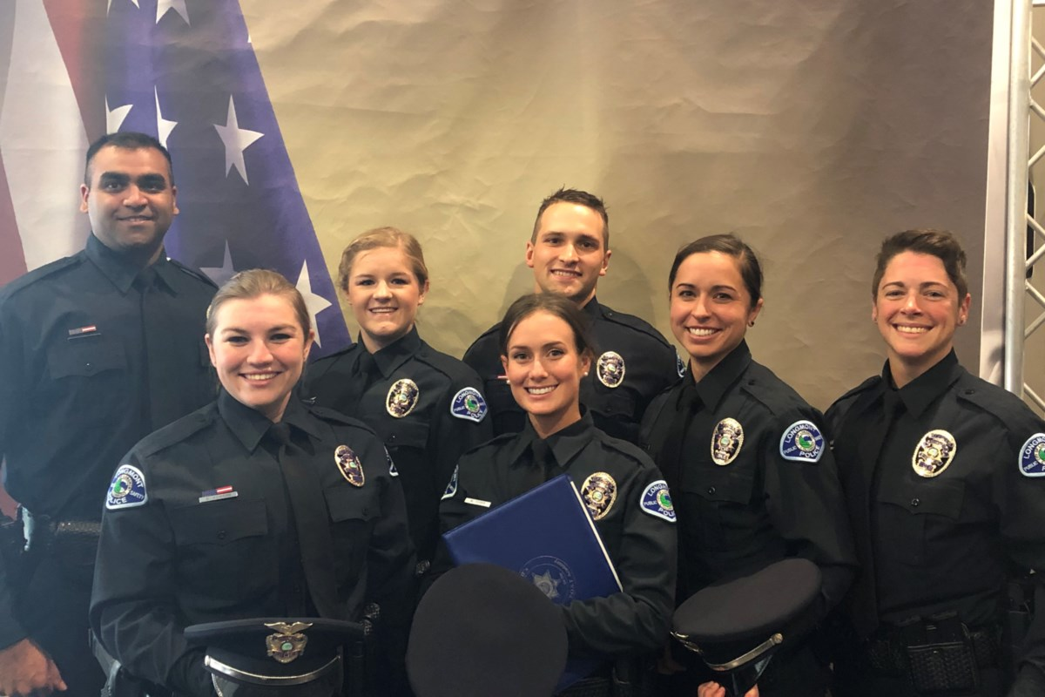
RECRUITMENT AND RETENTION
Hiring for 2022
  21 Officers hired in 2022
  12 months to hire and train
  $87,000 to train and outfit one recruit officer (does not include hiring / recruitment costs)
  22 Officers left in 2022 YTD (estimated $1.9 Mil impact)
Recruitment and Retention Challenges
  Agencies paying equal
  Some agencies offering signing bonuses
  Approximately 80% of the agencies in the northern front range have THVP
  Losing applicants and officers to agencies with a THVP
  Morale Booster
    87% of current officers would utilize a take home car program
28

Slide 29

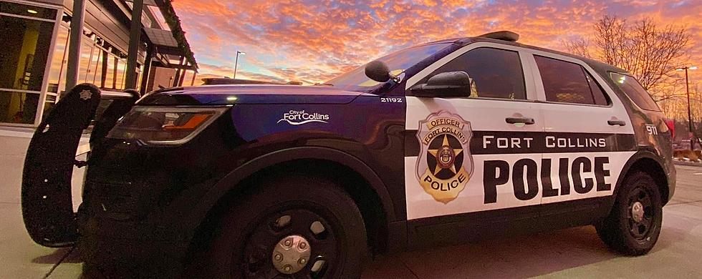

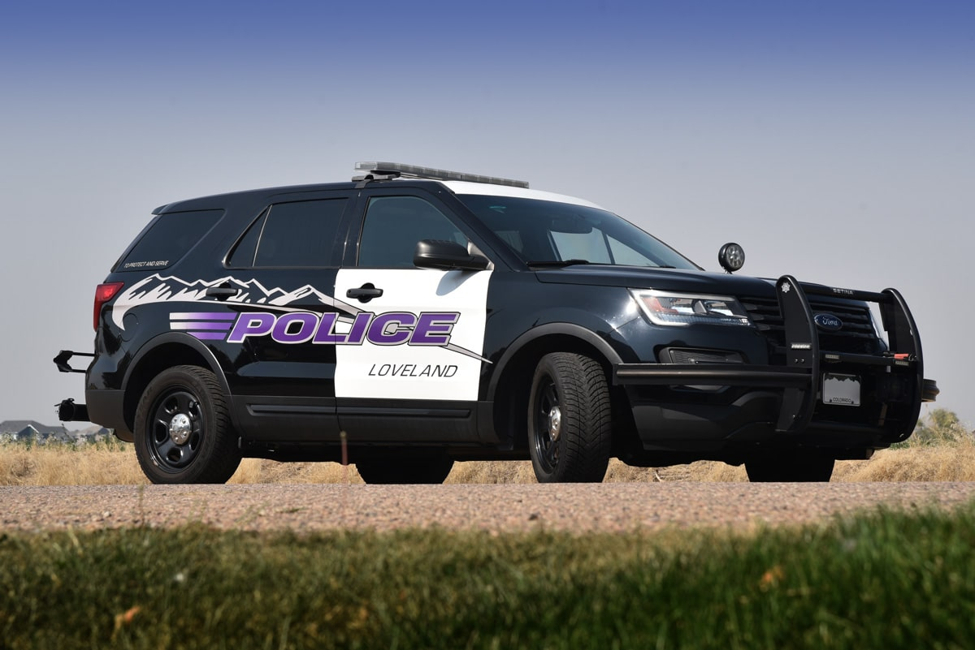
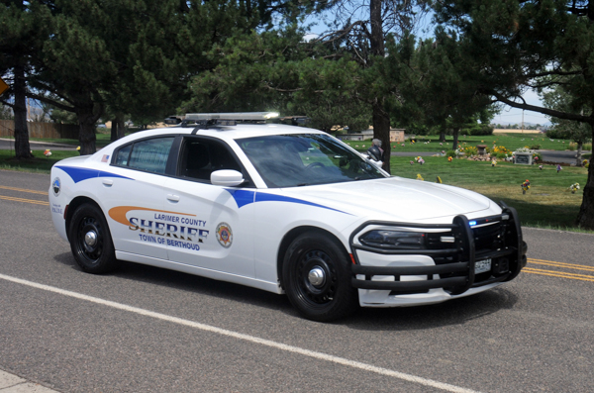

NORTHERN COLORADO AGENCIES W/THVP
Fort Collins PD
Loveland PD
Weld County SO
Larimer County SO
Windsor PD
Frederick PD
Colorado State Patrol
Boulder County SO*
Greeley PD and Mead PD (going to take homes in 2023)
29

Slide 30
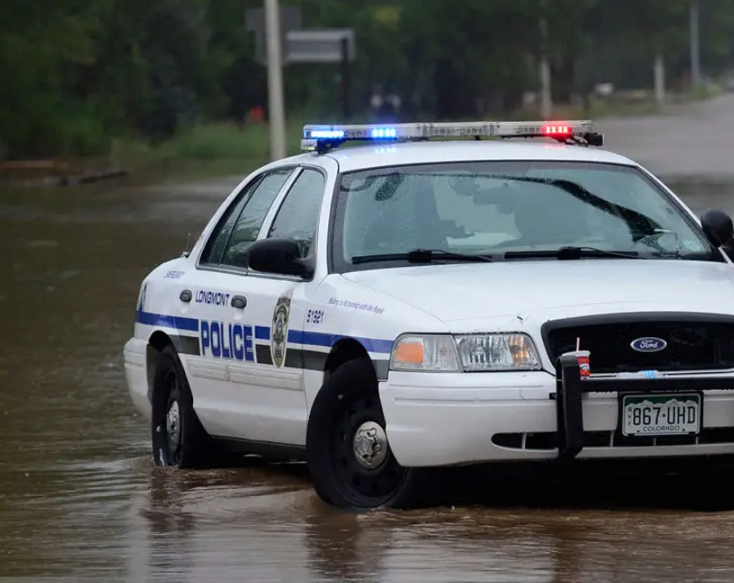
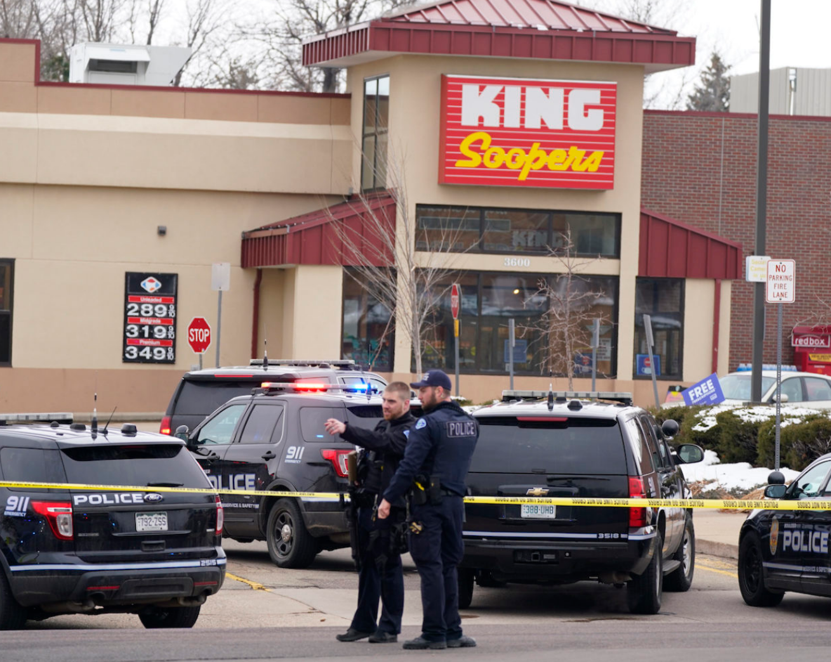
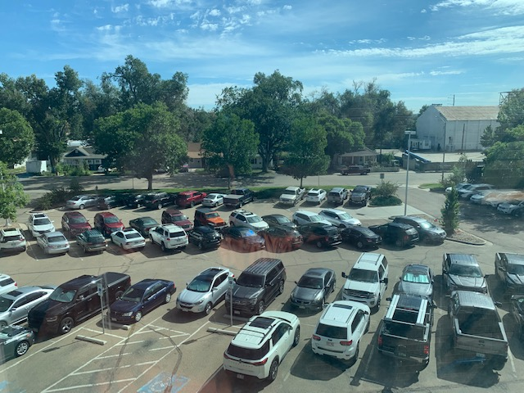
IMPACT THE SAFETY OF OUR CITIZENS AND STAFF
As a Force Multiplier
  Ready to respond to calls for service immediately
  Ready to respond to larger emergencies (eg. Marshall Fire, King Soopers, 2013 Flood, Homicide / BCIT investigations)
  Thousands of hours saved on loading, unloading and fueling daily = more officers on the street
  Quicker responses to in progress emergencies
  Quicker response when extra staffing is required (eg. next shift call ins, call-outs)
Safety for Staff and Community
  More parking at the Safety and Justice Building for the Community
  More officers on street = quicker response to CFS and greater ability to be proactive
  More available parking for professional staff
    Available spaces / Secured Underground Parking
  Officers personal vehicles not on site
  Officers familiar with their vehicles
    Equipment in the same place
    Familiarity with vehicle handling/capabilities
30

Slide 31
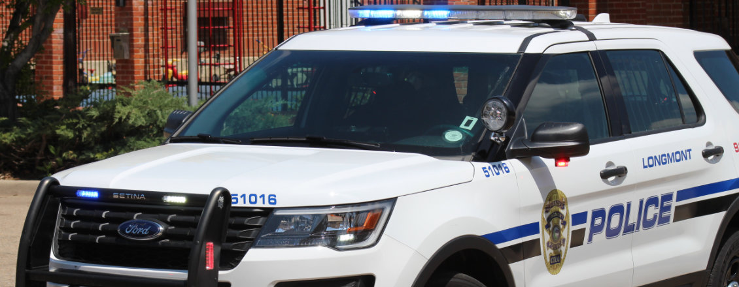
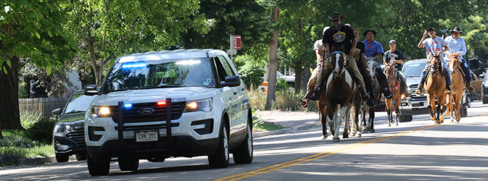
ACCOUNTABILITY
Accountability
  Officers are sole driver of a vehicle
    Better Care and Maintenance of the Vehicle
    Greater Longevity of the Vehicle
  Strict THV policy to avoid the potential for abuse
  25 mile residency restriction
  Minimal deviation from the most direct course from work to their residence
  Officer restricted with respect to off duty use
    No off duty use unless on call or authorized by the chief.
31

Slide 32
Take Home Car Program
Implementation
COST
ROLL-OUT
FINANCIAL GAIN TO THE CITY

Slide 33
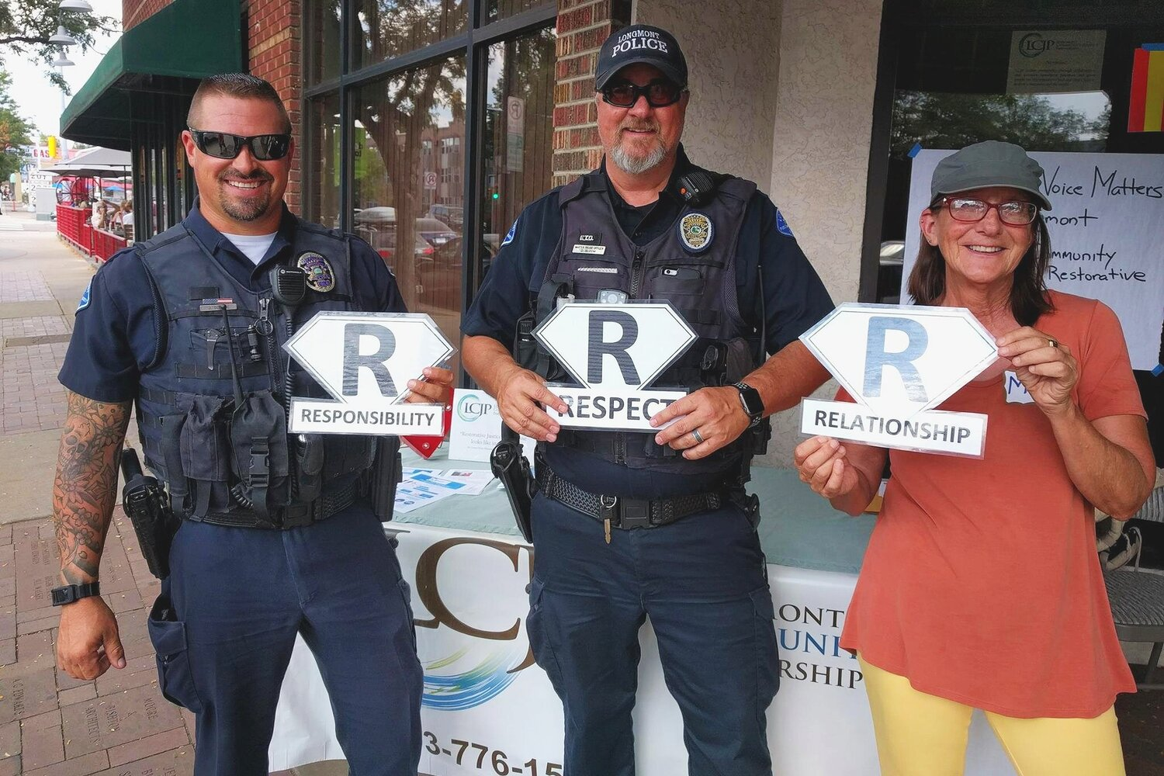
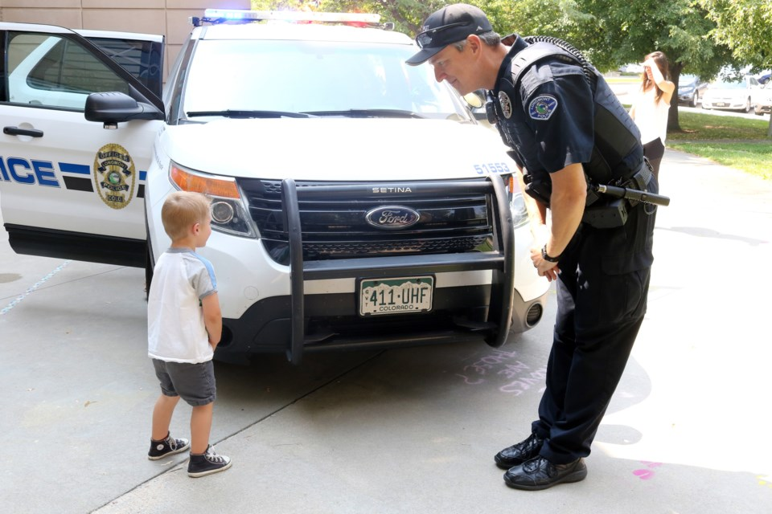
IMPLEMENTATION COST AND ROLL-OUT
Cost of the Program
Initial cost of the program will be $4.2 million over three years to purchase 59 total vehicles:
  43 Police rated and 16 Civilian rated
2023 funding to purchase 20 vehicles and to cover unexpected inflation for depreciation on current fleet:
  $1.44 million – General Fund
  $570,000 – Public Safety Fund
  Estimated increase to O and M yearly is $120,000.00
  Average Patrol vehicle cost with necessary equipment is $73,000 – Average Civilian rated vehicle with necessary equipment is $36,000
Three Year Rollout
  Vehicle Purchases:
    2023 20 Vehicles
    2024 20 Vehicles
    2025 19 Vehicles
    Allows for the cost of the program to have the least financial
  impact to the city in 2023 by dispersing over three years
  Allows fleet to greater ability to acquire vehicles (dealer avail)
  Allows vendors more time to build vehicles
  This will work in concert with Fleet moving towards hybrid vehicles
    Council’s city wide initiative
    Fuel cost savings (potential offset increase to O and M)
    Environmentally friendly
33

Slide 34
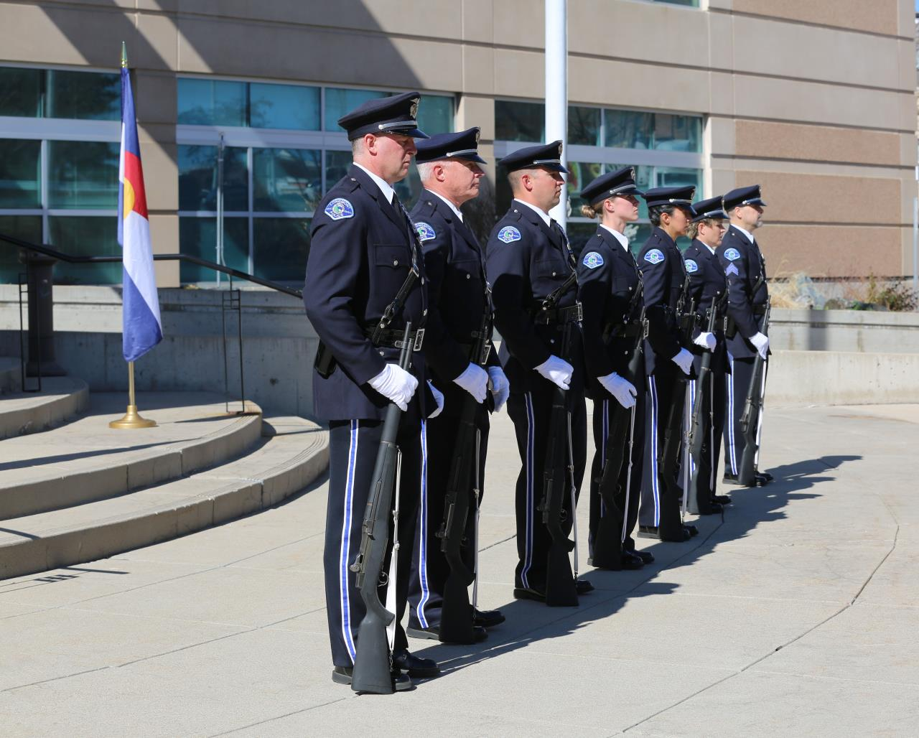
FINANCIAL GAIN TO THE CITY
Financial Gain to the City
  Program is based on 8 year rotation instead of 4 year rotation
      Estimated annual savings of $200,000 through less total annual depreciation cost
      The initial investment of $4.2 Million will be recuperated through savings over time
    Salary Savings
      Saves time between shifts and officers not having to be off the street to exchange vehicles
      An estimated 13,398 hours a year are spent on loading and unloading equipment, vehicle inspections, and refueling = to 6.5 FTE
      Annual soft cost savings of over $500,000
34

Slide 35

Other questions, comments or additional information needed?

