Slide 1

2023 CDBG/HOME ACTION PLAN & AFFORDABLE HOUSING FUND RECOMMENDATIONS
JUNE 20, 2023

Slide 2
HOUSING & COMMUNITY INVESTMENT PRIORITIES
5-year Consolidated Plan goals (2020-2024)
Maintain and produce affordable rental housing
Preserve existing affordable homeownership through rehabilitation and accessibility improvements
Provide new homebuyer opportunities
Housing stabilization service programs
Investments for community health & welfare
Economic development
Notes:
The Consolidated Plan is prepared in conjunction with the Boulder County/Broomfield Regional Consortium and sets shared goals, strategies, and funding priorities for program years 2020-2024 period.
The 2020-2024 Consolidated Plan outlines goals to pursue during a five-year period to meet community needs. CDBG and HOME programs advance the following objectives, for the benefit of low-and moderate-income (LMI) households:
Rental Housing Programs- Maintain and produce additional affordable rental housing, particularly for households with income below 50 percent AMI.
Existing Homeownership Preservation- Maintain and increase the inventory of affordable ownership homes by assisting low-income households with rehabilitation and accessibility needs to ensure decent, safe and sanitary housing conditions.
New Homebuyer Opportunities-Increase the inventory through innovative housing development models as opportunities arise, and by providing first-time homebuyer classes.
Housing Stabilization Programs- Work with community partners to provide housing resources and services to individuals and families at-risk of or experiencing homelessness.
Community Investments-Work with regional partners to coordinate investment strategies that fund programs and projects designed to impact existing conditions that threaten the health or welfare of the community, particularly for residents with low income and/or special needs.
Economic Development- Promotes job creation or retention through support for primarily micro-enterprises or small businesses.

Slide 3
2023 CDBG/HOME ACTION PLAN PROCESS
CDBG/HOME Program Year January 1 – December 31
2023 Action Plan due to HUD by August 16th
4th year of 5-year Consolidated Plan (2020-2024)
Public Hearing required (tonight)
30-day public review May 22- June 21, 2023
Any additional comments received will be included in the Action Plan will be provided to Council for consideration
Affordable Housing Fund (AHF) project selection pairs with CDBG/HOME Action Plan

Slide 4
CDBG FUNDING AVAILABLE
$474,607 for 2023
$45,102 reduction (9%) from 2022
Lowest award since 1993
$5,000 in estimated 2023 program income
$37,685 in reallocated funds from 2022
Total = $517,292

Slide 5
2Q 2023 FUNDING APPLICATION CYCLE
Letters of Interest (LOI) March 30-April 10
Application Period April 11-May 1
Community outreach
Historic partners
Community service organizations
Published in Times Call
City website
Pre-application support
Notes:
We put out a notice of funding availability between 2 and 4 times per year.

Slide 6
Total Requests
Advertised $3.77M in available funding
$5.53M in requests made for 8 viable projects/programs
Oversubscribed by $1.76M

Slide 7

CDBG FUNDING RECOMMENDATIONS
Boulder County Housing Counseling/Personal Finance Program
$50,000 grant
Required for DPA & Rehab Programs
210 lower income residents expected to be assisted.
Notes:
This program provides 1 on 1 financial counseling to Longmont residents who have applied for the Down Payment or Rehab programs or who have credit issues. Counseling includes developing a spending plan, reducing debt, and improving credit. It also includes foreclosure prevention and reverse mortgage counseling. The project leverages over $300,000 in other funding. Financial counseling helps keep people in their homes or helps people buy new homes, ensuring our residents can stay housed or move up in the housing spectrum, while managing their housing cost burden, reducing debt, and avoiding foreclosure.

Slide 8

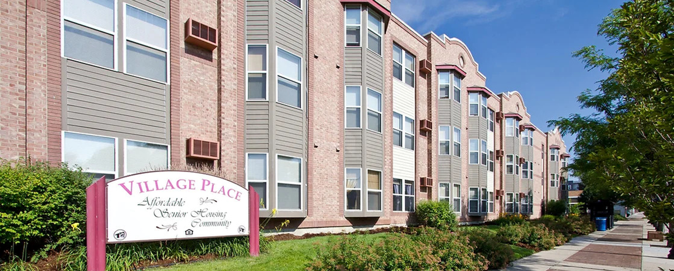
CDBG FUNDING RECOMMENDATIONS
Inn Between Roof Rehabs
$65,000 – grant
Assists ~ 20 households < 40% AMI
Two properties – 1901 & 1913 Terry Street
Village on Main Acquisition
$307,371 grant
LIHTC resyndication/rehabilitation
Leverages $22,800,000
72 units serving seniors < 50% AMI

Slide 9
CDBG FUNDING RECOMMENDATIONS
Program Administration
Set aside 20% - $94,921
Maximum allowed; does not cover full cost of delivering program
$422,371 in awards will serve 302 households
92 households served and affordable units preserved by acquisition/rehabilitation
210 households helped to maintain housing stability
$1,399 investment per household assisted
$23.36M leverage brought into community ($55.30 to $1)

Slide 10
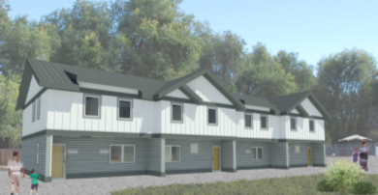
HOME FUNDING RECOMMENDATIONS 2023 – Longmont’s Year for HOME Entitlement Funds $784,252.80
Habitat For Humanity Sunset St.
$134,712 HOME Entitlement
4 owner occupied units in 2 duplexes at 137/139 Sunset Street for < 60% AMI
Application to Consortium’s CHDO set-aside for remainder of request
Inn Between – Wesley Homes
$599,240.80 HOME Entitlement
11 new PSH rental units at 350 11th Avenue (Heart of Longmont Church)
Will serve < 40%AMI

Slide 11
AHF FUNDING AVAILABLE
$6,365,456 total budget for 2023
Revenue
$1,206,543 from General Fund Transfer (includes admin)
Estimated $300,000 from Marijuana Tax
Estimated $1,265,432 from Fee-in-Lieu revenue
$1,600,000 in estimated 2023 program income
Expenditure Set-Asides
Program Administration – $600,000
Carry over projects from prior year – $1.8M
Estimated fee offsets – $178,142

Slide 12

AHF FUNDING RECOMMENDATIONS
Thistle – Kimbark Apts Rehab (security improvements)
$33,000 loan – 0%, 5 year term
Village on Main Acquisition
$192,629 loan – 0%, 43 year term

Slide 13
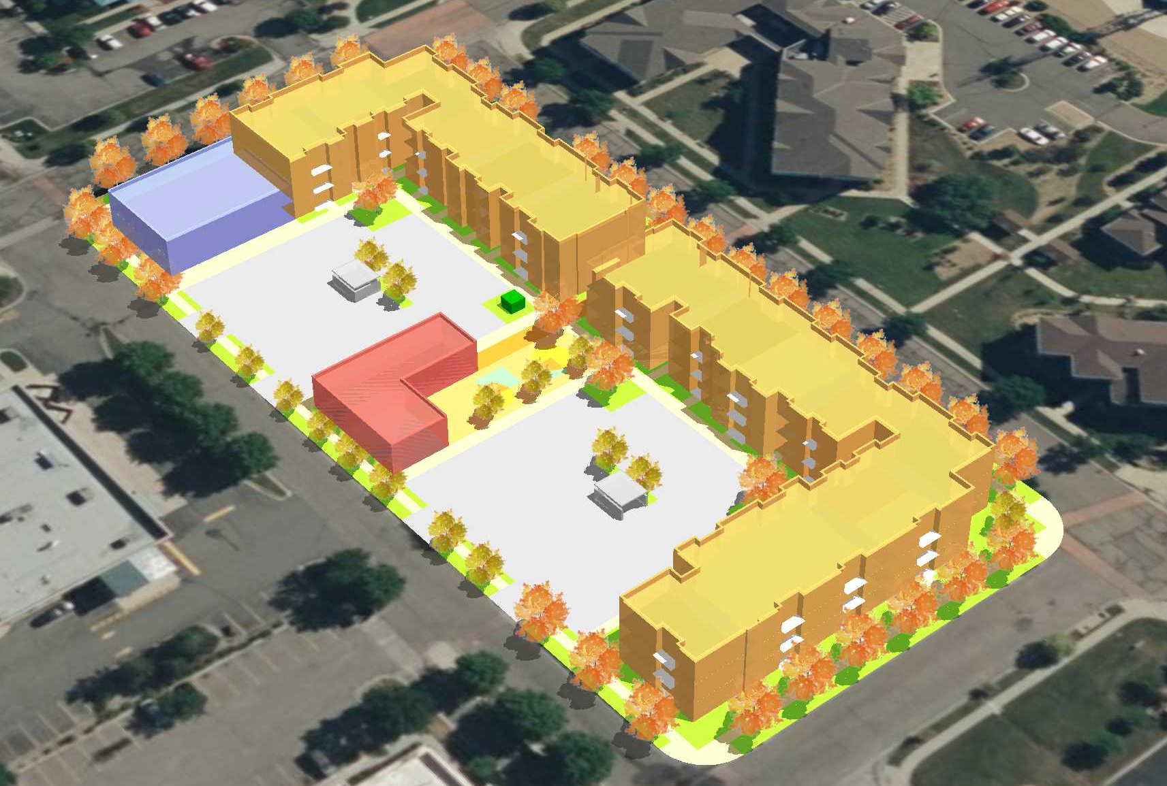
AHF FUNDING RECOMMENDATIONS
Inn Between Wesley Homes
$341,409 – 1% interest loan
Ascent at Hover Crossing (formerly Homes on Hover)
$1,800,000 – 1% interest loan
75 new mixed income units
Atwood Commons Apartments
$1,000,000 – 1% interest loan
72 new mixed income units

Slide 14
AHF FUNDING RECOMMENDATIONS
Total competitive award – $3,367,038
Raised from $2.5M advertised due to timelines of projects
194 households to be served
74 new affordable rental homes created, plus 84 serving 70-80% AMI supported through LIHTC income averaging
4 new homeownership units created
$17,356 investment per household assisted
$90.17M leverage brought into community ($26.77 to $1)

Slide 15
CDBG 2023 ACTION PLAN PUBLIC HEARING
Questions about the proposed program?
Hold Public Hearing
Take action on approval of 2023 CDBG Action Plan and 2nd Quarter AHF recommendations

