Slide 1

INCLUSIONARY HOUSING PROGRAM REPORT
2022
July 18, 2023

Slide 2
PRESENTATION OUTLINE
2022 Inclusionary Housing Annual Report
2023 Sales Price Maximum update
Root Policy Research:
  Housing Needs Assessment
  Inclusionary Housing Policy Review
    Ordinance Structure & Fee-In-Lieu
IH policy discussion
Notes:
We will pause for questions in between major sections.

Slide 3
2022 Inclusionary housing annual report
Notes:
Note that usually include housing market analysis data here, but we have the Root study to go over this year. As part of the Root contract, we will be building a Data Dashboard to get data in real time as soon as it comes out. As the IH program matures, and if Council desires, we can provide annual reports as Council informational items, but use the data dashboard as our primary reporting mechanism.

Slide 4
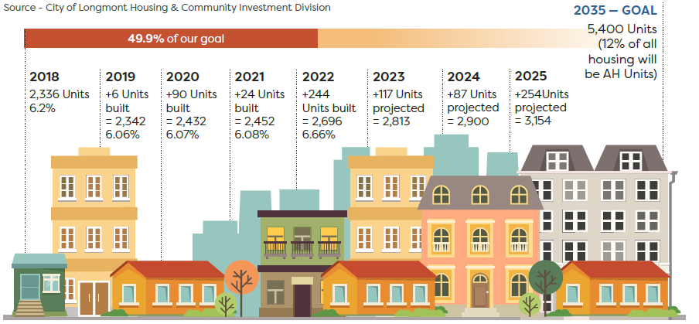
AFFORDABLE UNIT GENERATION
Notes:
245 rental units created, 0 for-sale created, 1 for-sale lost since the deed restriction expired
3 LIHTC projects delivered 219 units
2 market rate projects delivered 59 units provided onsite
2022 saw the largest single-year unit generation gain since the City started tracking annual gains in 2003.
Annual average since 2017 is 101 units, 2017-2021 = 72
Need to generate 208 units per year from 2023-2035 to make this goal.
Average annual generation anticipated 2023-2025 is 127 units

Slide 5
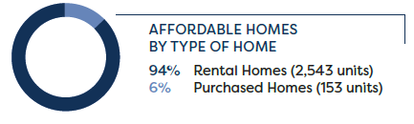
AFFORDABLE HOMES PROVIDED
What we track:
Permanently affordable units
Likely to remain affordable units
Notes:
Summarize slide
Currently track permanently deed restricted units and units likely to remain affordable that are restricted by another means, usually LIHTC LURA. Income averaging may result in tweaks to how we track units in the next 2 years.

Slide 6
DOLLARS INVESTED
The City’s ARPA investments contributed to the boost in unit generation in 2022.
Notes:
ARPA boosted units, but just playing catch up, didn’t get us ahead.

Slide 7
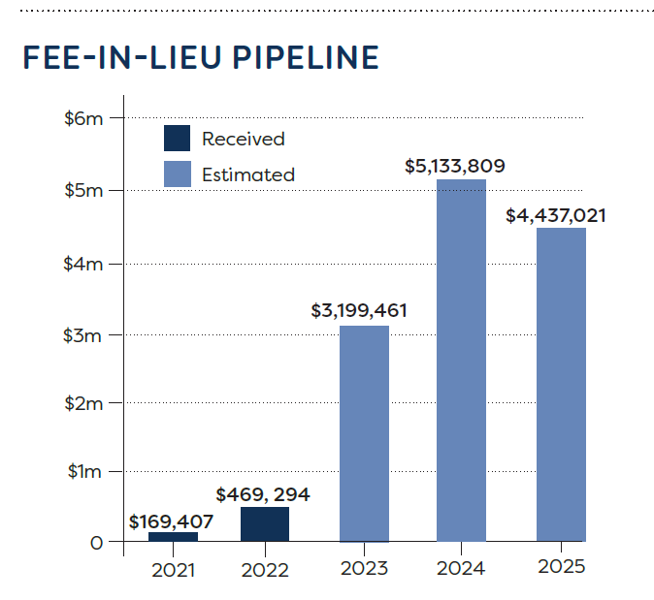
PAYING FEE-IN-LIEU
$653,323 in Fee-in-lieu received since IH program started.
Notes:
Based on projects anticipated to obtain CO in development pipeline. Subject to change.
As Longmont’s raw land gradually gets developed, we should expect to move into a redevelopment phase, so we may expect a peak in FIL, then level off as smaller projects are proposed in the coming decades.
Already exceeded $700,000 in revenue so far in 2023

Slide 8
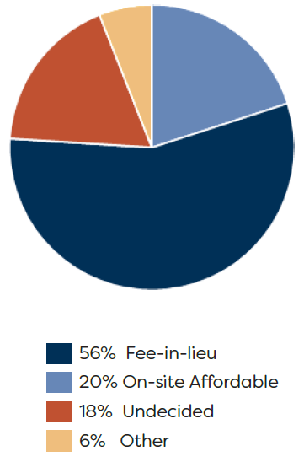
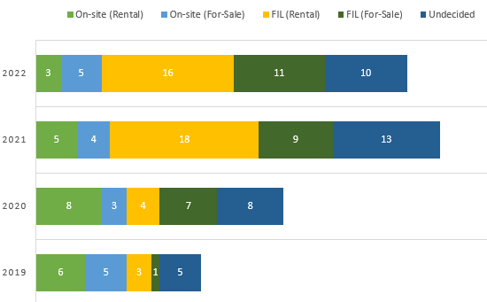
COMPLIANCE OPTION SELECTION
2022
Notes:
We saw a minor decrease in the number of IH required residential building projects. We speculate this is due to external changes in the market.
We can see that as residential construction increased and market conditions changed as a result of COVID, around 2021, there was a sharp increase (145%). A trend that is still being seen today 56% of projects select the FIL.
On-site units have consistently decreased.

Slide 9
MIDDLE-TIER PIPELINE
Middle Tier | Affordable Requirement
80-100% | 100% reduction
100-110% | 60% reduction
110-120% | 20% reduction
2019-2022 | 100% | 110% | 120%
Townhomes (Proposed) | 53 | 21 | 17
Townhomes (Sold) |  | 1 | 1
Proposed Condos |  |  | 347
Condos (Sold) |  | 4 | 5
Notes:
We now have comprehensive data on the developments that considered, but then moved away from the middle-tier option. These numbers show those that were built and sold under the middle tier price point. The remainder were sold above the price point.
Last year, we discussed with you how the middle tier option in IH code was not resulted in units delivered in the 80-120% AMI affordability range.
In October 2022, we updated the sales price maximum calculation methodology. We do not yet have any developments that have reported they are working towards utilizing the middle-tier option.
Note that we are analyzing the middle-tier option as we work to implement an attainable housing fee waiver program. Future recommendations for changes to right-fit the middle-tier option with the fee waiver program may be forthcoming.

Slide 10
IH ACCOMPLISHMENTS AND OUTLOOK
Accomplishments
  Revised sales price maximum methodology
  DRC process improvements
What we want to accomplish in 2023:
  Minor code cleanup
  Deed restriction sale price limit modification
  Middle-tier option right-size
  Fee-in-Lieu update (or modification)
  Other consultant recommendations for IHO structure
Notes:
DRC process improvements
HCI staff integrated into accela development tracking system
Results in better FIL payment tracking
AH application now integrated into permit submittal materials
Starts process earlier, cuts down on miscommunication
IH data points being tracked in accela
Moving towards automation and better data-driven decision making

Slide 11
2023 SALES PRICE MAXIMUM UPDATE

Slide 12
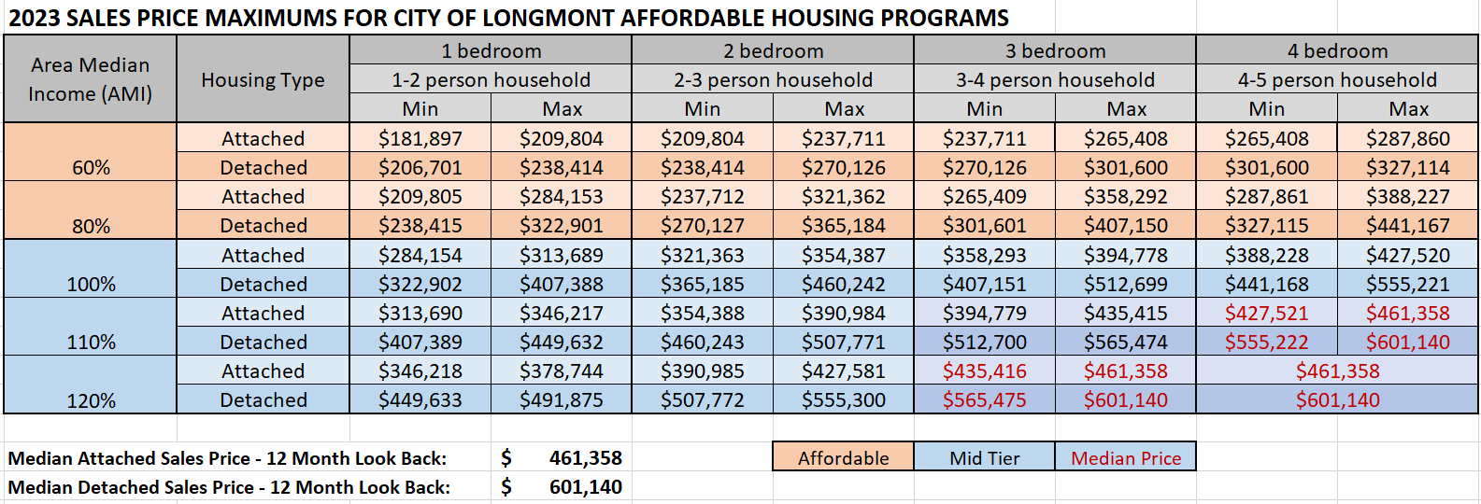
SALES PRICE MAXIMUM UPDATE
Notes:
Informational – this was updated in May when 2023 HUD income limits came out. Live and on webpage now.

Slide 13
QUESTIONS ON IH ANNUAL REPORT?

Slide 14
Longmont housing affordability & IHO Policy review
PRESENTED by
Mollie Fitzpatrick, Managing Director
Denver, Colorado 80220
970.880.1415
hello@rootpolicy.com

Slide 15
Housing Affordability Needs

Slide 16
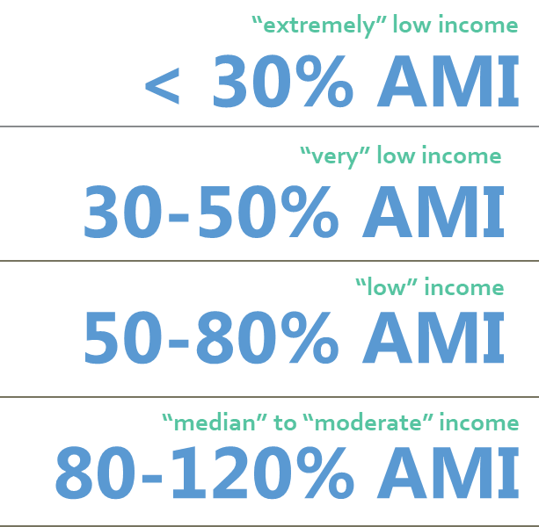
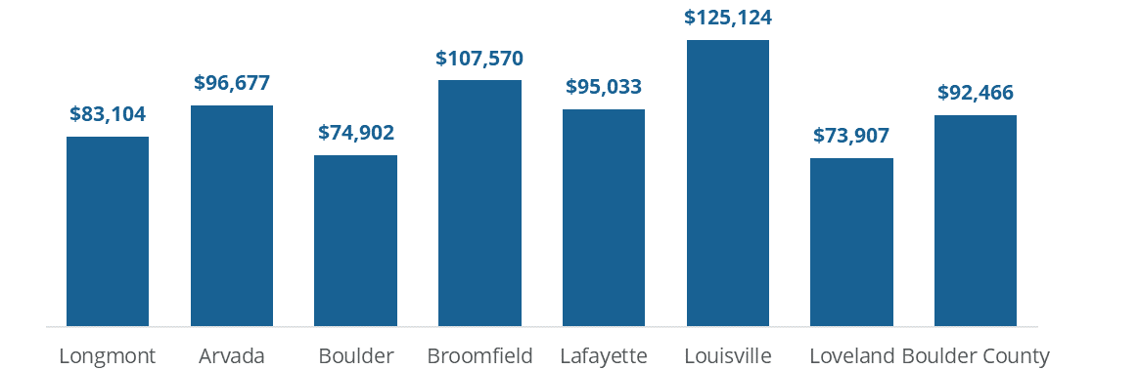
Defining Affordability
Regional HUD Area Median Income (AMI):
Housing programs rely on income limits published by the U.S. Department of Housing and Urban Development (HUD) that are represented as percentages of the area median family income (commonly abbreviated as “HUD AMI” or simply “AMI”).
2023 HUD Regional AMI is $106,300 for a 2-person household.
Affordability is typically linked to the idea that households should not be “cost burdened” from housing costs—spending more than 30% of gross income on housing costs.
Median Household Income:
Longmont and Peer Communities, 2021 ACS data

Slide 17
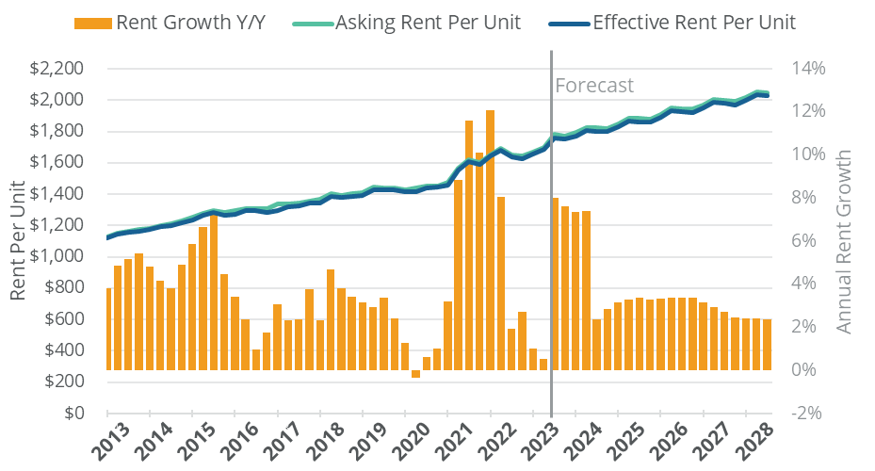
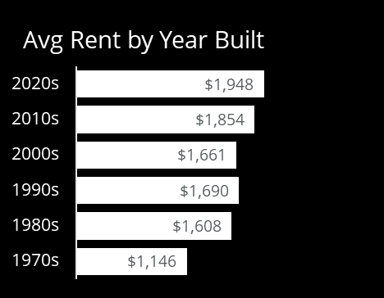
Rising Rents: The average market-rate rent in 2023 ($1,700) generally serves households earning 60% to 80% AMI (depending on household and unit size).
New construction (median rent $1,950) typically serves renter households at 70% to 90% AMI (depending on household and unit size.

Slide 18
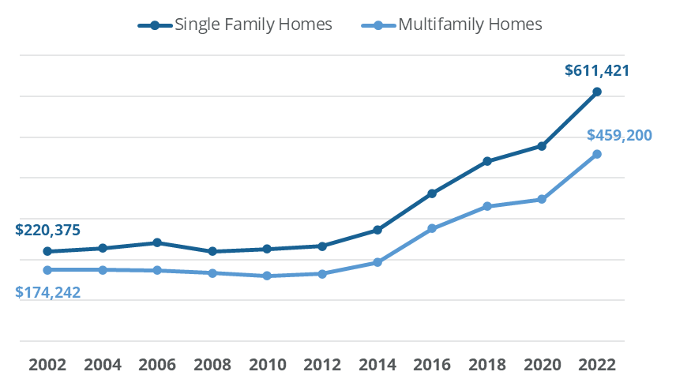
Rising Home Prices
The median sale price of $611,421 is only affordable to 32% of Longmont households—those earning more than about 120% AMI (depending on household size). The median price is only affordable to 15% of Longmont renters—the pool of potential first-time buyers.
The rise in home prices substantially outpaced incomes over the past 5 years. These trends coupled with rising interest rates are pushing homeownership further out of reach for many Longmont households.

Slide 19
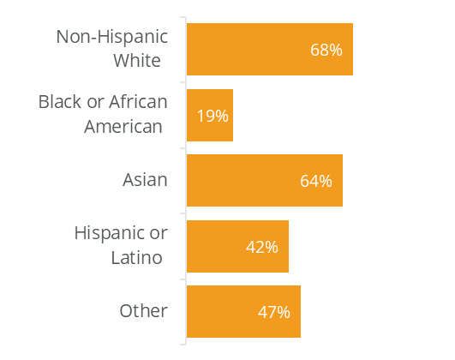
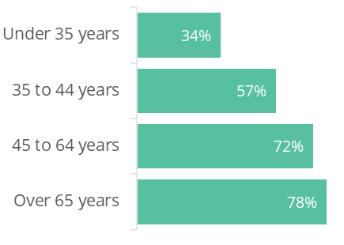
Home-Ownership
64% of Longmont households are owners, but there are disparities between demographic groups:
Homeownership is out of reach for many Longmont workers:
the median sale price is unaffordable for the average wage worker across all industries, even with 1.5 earners per household.
Age of Householder
Race/Ethnicity

Slide 20


Affordability Gaps
Mismatches in supply and demand by price-point for current Longmont residents
The affordability gaps analysis indicates that affordability needs are concentrated below 50% AMI in the rental market and below 100% AMI in the for-sale market (though for-sale needs do persist up to 120% AMI.
Affordability gaps can be addressed through new production of housing units at the needed price-points or through subsidies of existing units.
Rental Affordability Gap
For-Sale Affordability Gap

Slide 21
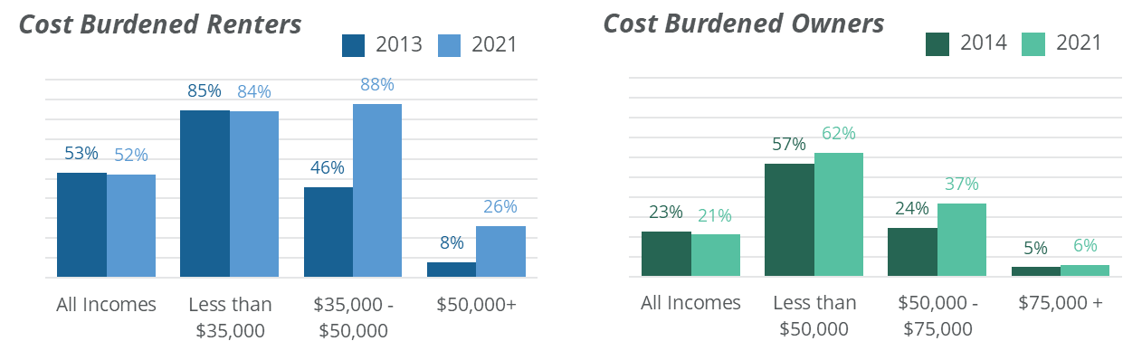
Cost Burden:
Nearly 7,000 households in Longmont are cost burdened and another 5,700 are severely cost burdened. Cost burden and severe cost burden collectively affect over half of Longmont renters and one in five Longmont owners.

Slide 22
Addressing Needs & Accommodating Growth
As part of the Boulder County Regional Housing Partnership, the City of Longmont has adopted a housing goal of achieving 12% of its housing stock deed-restricted and affordable by 2035. Growth projections indicate the 12% target requires a total of 5,400 affordable units by 2025. The City is about halfway to its affordable production goal at present, with 2,696 income-restricted units accounting for 6.7% of the total housing stock.
In addition to addressing the City’s existing affordability needs, the City should also be prepared to absorb additional housing demand created by both economic and population growth in the City. This will require the addition of both market-rate and affordable housing stock across a variety of product types (e.g., apartments, townhome, duplexes, single family, etc.) in order to meet market preferences and changing demographics. Demographic shifts toward an older population also signal a need for more accessible/adaptable housing units (or programs) in Longmont.

Slide 23
Questions on Housing Needs Assessment?

Slide 24
Inclusionary Policy Review

Slide 25
Affordability Requirements
Root Policy Recommendations:
The current AMI targets are in line with identified housing needs (discussed in detail in the City’s Housing Needs Assessment) and the set-aside is in line with City’s 12% affordability goal. In addition, the City offers flexibility to developers wishing to provide deeper AMIs and to those providing middle tier housing. As such, there are no recommended changes to the affordability requirements of the current program.
It is important to note that the City’s IHO program alone is an insufficient tool to fulfill the entire affordability goal and/or fully address housing needs—unless paired with other subsidies, programs, and partners (e.g., LIHTC, state/local funding, housing authority, non-profit housing developers, etc.)
The City’s program currently requires a 12% set-aside of units at 50% AMI for rental and 80% AMI for owner units.

Slide 26
Compliance Options
Root Policy Recommendations:
Raise the fee in lieu.
Streamlining the approval process for on-site rental production.
Amend the credit compliance option (to prohibit credit allocation for any project receiving federal, state, or local subsidies).
Ensure a clear path for land donation and clarify evaluation criteria for Council approval.
The most common compliance option used by developments subject to the IHO is the fee-in-lieu (56%), followed by building units on-site.
A few developers have also used the land donation and middle-tier housing options.

Slide 27
Fee in Lieu
Most cities with an inclusionary housing ordinance offer a “fee-in-lieu” compliance option, which allows developers to pay a specified fee instead of constructing the affordable units.
Fees can be structured on a per square foot or per unit basis and range from nominal fee amounts up to the full cost of developing the affordable unit, depending on the policy priorities of the program.
In general, low fees incentivize developers to pay the fee-in-lieu rather than build units, which contributes to revenue generation but results in relatively few affordable units constructed as part of the inclusionary program. High fees are more likely to incentivize developers to construct units on site and would result in lower revenue generation.
Set according to policy priorities and established methodologies.

Slide 28
IHO Fees for Front Range Programs
NOTE: Different programs reflect varying policy priorities impacting fee-in-lieu amounts. As such, comparison between communities is not a benchmark for adjusting current fees but does provide context for current fee structure.

Slide 29
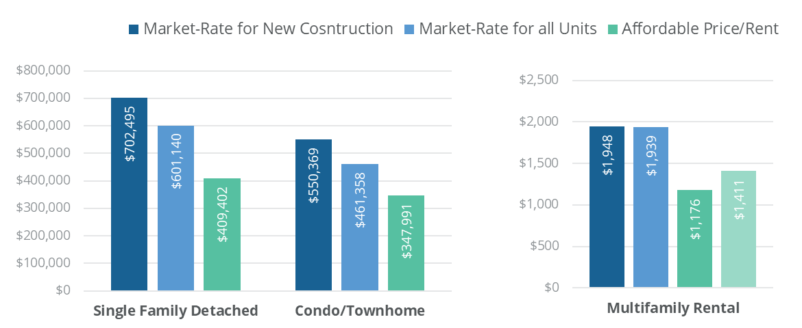


Common Methods for Fee in Lieu Calculations
Gap between Market-Rate and Affordable (2022)
Affordability Gap Method (used by Longmont for current fees)
Development Cost Method
Affordable Unit Development Costs (2022)
$422,128 per unit
$386,673 per unit

Slide 30
Longmont IHO Fee Options
Affordability Gap with a data update;
Modified Affordability Gap (new construction baseline);
Development Cost method.
Longmont’s current fees are too low for the City to effectively use the fee revenue to create an equivalent number of affordable units, without leveraging other subsidies.

Slide 31
Upcoming Deliverables
What other areas should be explored for further study?
IHO Incentives Review
Data Dashboard
Attainable Housing Deed Restrictions Market Comparison

Slide 32


Slide 33
COUNCIL POLICY QUESTIONS
Direction on IHO Structure
  Should we remove the VAA requirement?
  Should we amend the credit compliance option?
  Should we look closer at the land donation option?
Direction on Fee-In-Lieu
  Should we update calculation according to existing code?
  OR
  Should we select a Root-recommended modification?

Slide 34
Longmont IHO Fee Options
Affordability Gap with a data update;
Modified Affordability Gap (new construction baseline);
Development Cost method.
Longmont’s current fees are too low for the City to effectively use the fee revenue to create an equivalent number of affordable units, without leveraging other subsidies.
Notes:
REMINDER SLIDE IN CASE NEEDED

Slide 35
FEE-IN-LIEU METHODOLOGY COMPARISON
Affordability Gap
Development Cost
Generates revenue
Provides gap funding
Leverages outside funding
May concentrate low-income people into specific projects
Relies on developers to produce units
Mixed income neighborhoods
What are the unintended consequences, if any?
Notes:
BACKUP SLIDE ONLY IF COUNCIL WANTS TO TALK ABOUT DEVELOPMENT COST METHOD

